Slide 1
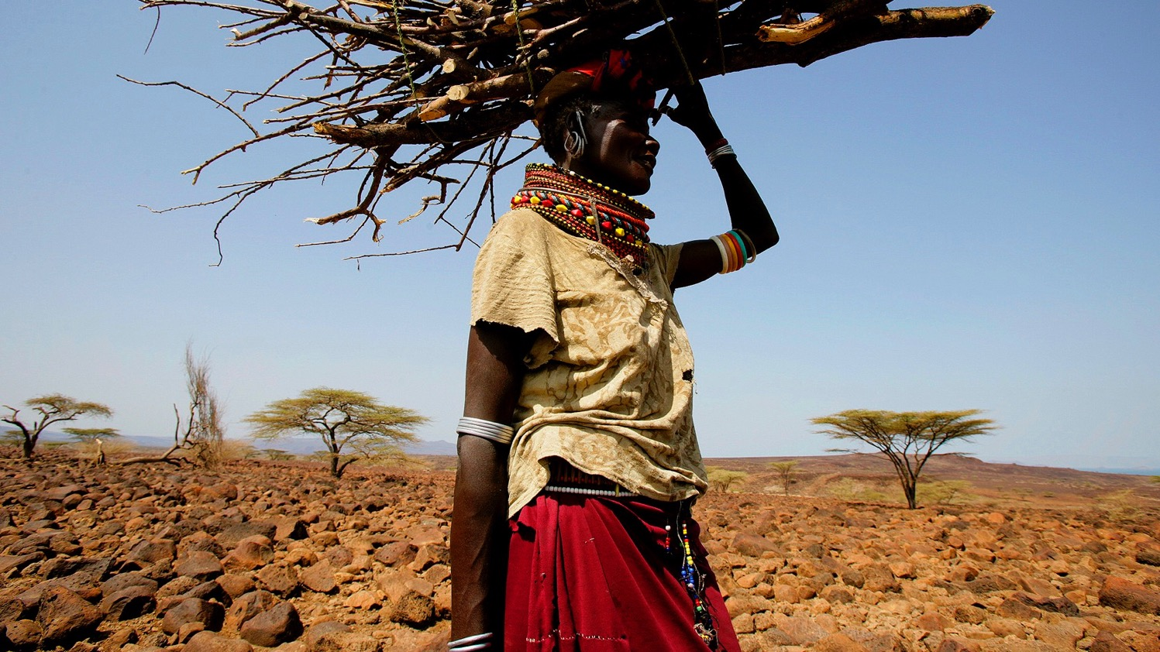
SCALING POVERTY-ALLEVIATION DEVELOPMENT
PROJECT DEVELOPER + NGO TRACK
Bernardo Lazo, Director of Partnerships + Business Development, Gold Standard
Abhishek Goyal, Senior Technical Director of Standards, Gold Standard
Richard Iliffe, Standards Manager, Gold Standard
Vikash Talyan, Technical Director of Standards and New Programmes, Gold Standard

Slide 2



POVERTY ALLEVIATION
How can we ensure that the market supports projects that improve the lives of the poor?
Through differentiation and visibility in the market
Through other market support initiatives
Notes:
Gold Standard is know for projects that provide services and opportunities to the worlds poorest and most vulnerable communities. These projects have immense co-benefits, particularly in human development areas such as SDG 1, 3, 5 and 6. While some buyers can discern the value of these projects and actively seek out credits issued from them, others may not realise or the credits may be difficult to differentiate from other types. One question we are asked regularly at GS is whether a ‘tag’ to differentiate and improve visibility of the credits would add value and if there are other ways to support the projects in the market place. This workshop will explore these questions [MAKE CLEAR THIS IS ABOUT THE MARKET PLACE NOT THE PRACTICALITIES OF MRV/CERTIFICATION ETC]

Slide 3
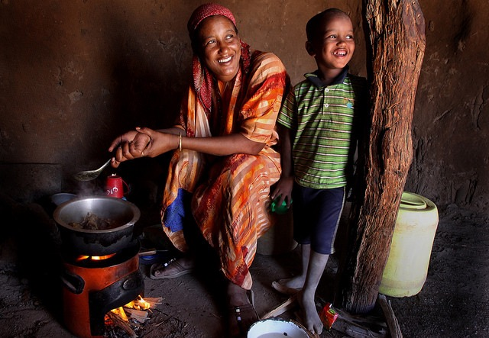

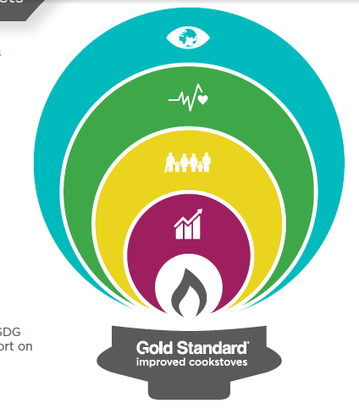
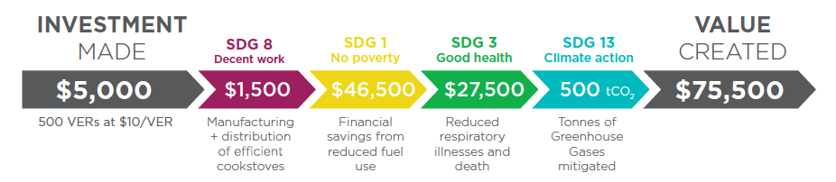
VALUE CREATED TO SDGS: COOKSTOVE EXAMPLE
Notes:
We commissioned a report on the shared value of different project types, it can be found on our website. Here you can see the benefits derived from just one of these project types and this is something we intend to explore further this year.

Slide 4
VISIBILITY IN MARKET PLACE
Would a project ‘tag’ that indicates
that a project serves poor communities:
add value to credits
make it easier to credits
Definition of services provided and benefits derived
Definition of poverty
Notes:
Does the introduction of SDGs solve the challenges developers may have had in differentiating themselves from projects that do not target poor communities?

Slide 5
EXERCISE
Split into groups and discuss the potential for a ‘tag’ that differentiates projects that provide poverty alleviation services, based on the following questions. Each group will be asked to give a short overview of the findings and these will be used to inform the next round of dialogue
Would a tag help projects to sell their VERs and help buyers easily identify them in a crowded market-place?
Are there any dis-benefits or risks?
Should a tag focus on identifying poverty (and poverty alleviation), or identifying basic services (and supplying these); or both?
How should we define impoverishment and basic services so that the tag is straightforward but also credible? Should it be based on SDG 1 or separate from the SDGs?
And finally:
Do you see any other solutions? What else could we do to give these credits the best chance in the market?
Notes:
Does the introduction of SDGs solve the challenges developers may have had in differentiating themselves from projects that do not target poor communities? Consider this in session

Slide 6
QUESTIONS?

