Slide 1

BUSINESS LEADERSHIP ON CLIMATE + SDGS
CORPORATE TRACK
Sarah Leugers, Director of Communications, Gold Standard
SOCIAL MEDIA
@cdmgoldstandard
#GrowToZero
WWW.SLIDO.COM
1025
WIFI
Network: Gold Standard
Password: 180418GoldStandard

Slide 2

TODAY’S AGENDA
CORPORATE TRACK
Business Leadership on Climate + SDGs
“Finance Beyond”: How companies can use markets to reduce emissions + contribute to sustainable development
CDP: Best practices in addressing corporate value chain emissions

Slide 3
WORKSHOP AGENDA
9:30 – 9:50 | Leadership for climate +SDGs: Why and how? State of play for corporate engagement Best practices for climate leadership Best practices for an SDG strategy Gold Standard for the Global Goals: A tool to accelerate progress
9:50 – 10:30 | World café discussions: Climate SDGs
10:30 – 10:50 | Report on discussion + key takeaways
10:50 – 11:00 | Summary
Notes:
Objectives:
The idea is to build consensus, to the extent possible.
Launch the public consultation
Begin gaining your feedback as part of this consultation -
Announce a few new initiatives that demonstrate action within different ‘components’ of the guidelines

Slide 4


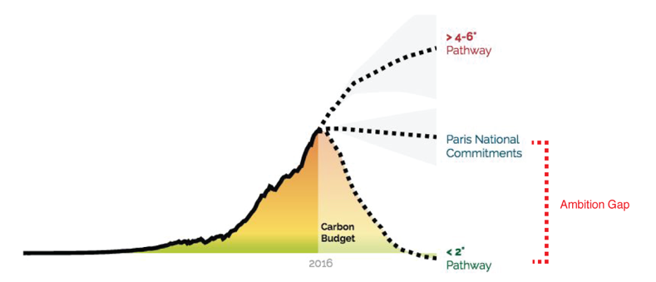
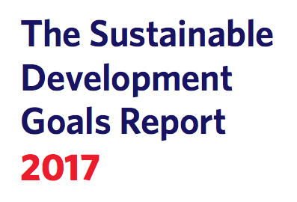
LEADERSHIP FOR CLIMATE + SDGs: WHY?
“The rate of progress in many areas is far slower than needed to meet the targets by 2030.”
Notes:
Leadership on climate and the SDGs is both INVALUABLE and VALUABLE
VALUABLE

Slide 5

WHY VALUABLE?
$12 trillion market opportunity
Customer trust and loyalty
Reduced risk
Creation of ‘shared value’ in environmental + social impacts

Slide 6
ENGAGEMENT WITH THE SDGs
79% acknowledge the SDGs
45% had started to align their sustainability strategies with goal-level SDG criteria
Only 6% have aligned their strategy to target-level SDG criteria and measured contributions to key SDGs
Notes:
Development (WBCSD) found that 79% of the 157 companies analysed
acknowledge the SDGs in some way; 45% had started to align their sustainability strategies
with goal-level SDG criteria; but only 6% have aligned their strategy and targets to specific
target-level SDG criteria and measured their contributions to key SDGs

Slide 7
SLIDO QUESTION
Where are you, or most of the clients you represent, on your journey toward SDG leadership?
No internal acknowledgement of the SDGs
Some internal discussion but no reference of the SDGs in reporting
Acknowledge the SDGs in reporting
Have started to align sustainability strategies with goal-level SDG criteria
Have aligned their strategy to target-level SDG criteria and measured contributions to key SDGs

Slide 8
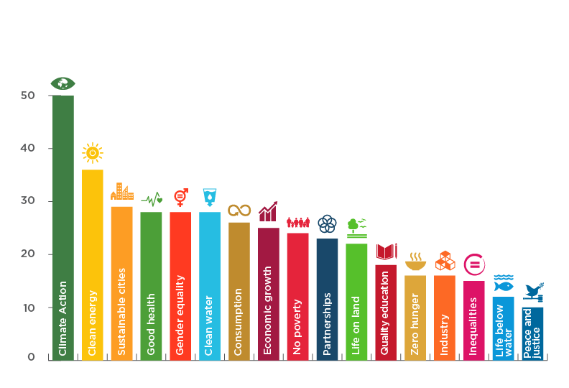
PRIORITY SDGs
>5000 reporting to CDP
380 setting Science Based Targets
131 committed to RE100
447 committed to high-risk deforestation free commodities
Notes:
UN report released in April 2017 found that 82 out of 100 blue chip companies demonstrated commitment to the SDGs in their 2016 annual reports, either through explicit statements about the goals or implicit actions that support them. SDG 13 (Climate Action), SDG 3 (Good Health) and SDG 10 (Reduced Inequalities) were top priorities.

Slide 9







CORPORATE
CLIMATE
LEADERSHIP
FINANCE the global transition to a zero-carbon resilient economy
ADVOCATE for strong policy frameworks
REDUCE climate impact + risk in line with science
MEASURE + DISCLOSE climate impact and risks

Slide 10
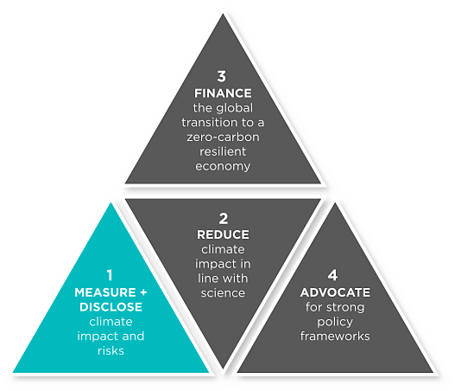
PILLAR 1: MEASURE + DISCLOSE
Conduct complete GHG accounting per the GHG Protocol with third party verification.
Transparently report full scope 1-3 emissions.
Implement an internal or “shadow” price on carbon high enough to materially affect investment decisions.
  e.g. Internalise the environmental and social costs of GHG emissions by implementing a carbon fee to support the investment in renewables and climate protection projects and incentivise further emission reductions.

Slide 11


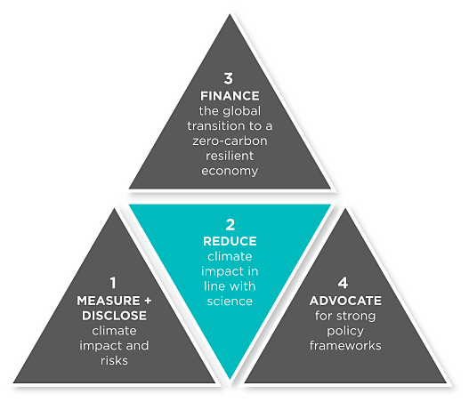
PILLAR 2: REDUCE CLIMATE
IMPACT + RISKS
Set and implement GHG emission reduction targets based on science
Define a transition plan to your company, designing and thinking through your own company transition scenario to a low-carbon economy
Start to implement your transition plan and get it assessed by an Assessing low-Carbon Transition (ACT) methodology to ensure strategic planning and investment decisions are aligned with the low-carbon transition

Slide 12

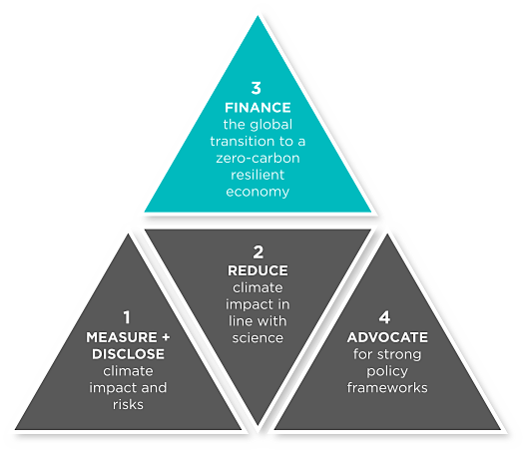
PILLAR 3: CONTRIBUTE TO
CLIMATE FINANCE
Internalise costs of unabated GHG emissions and contribute to close the finance gap.
Potential methods and mechanisms:
  Carbon credits
  Value chain mitigation + adaptation
  Contribute to a new fund
  Purchase, fund or build renewable energy

Slide 13
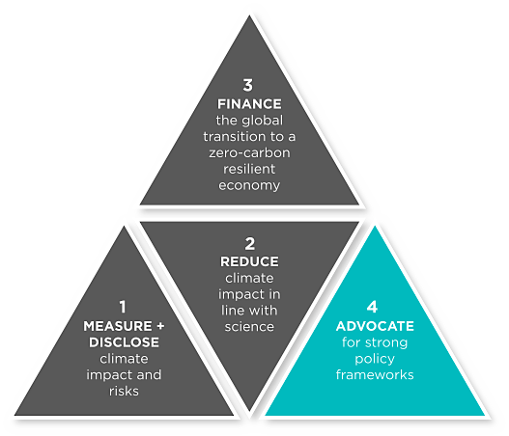
PILLAR 4: PARTICIPATE IN ADVOCACY
Influence market or policy developments by promoting your vision, solutions and achievements.
Engage suppliers in your climate strategy.
Inspire constituents to also strong climate action through initiatives like employee engagement programs, consumer matching programs, which can also lower your own GHG footprint.
Begin educating your investors, employees, and customers about climate impacts and your climate strategy.

Slide 14
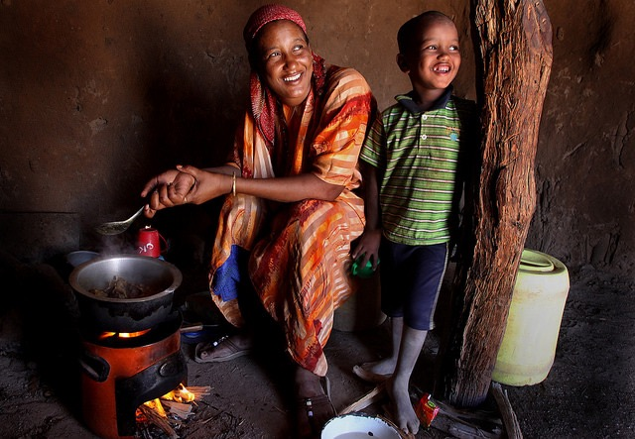

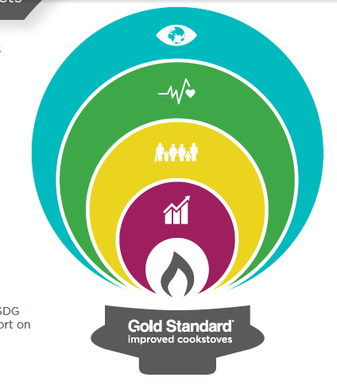
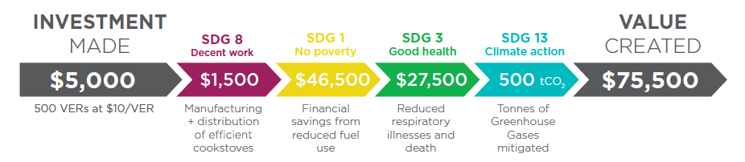
SDG VALUE CREATION FROM CLIMATE ACTION
Notes:
15x ROI

Slide 15
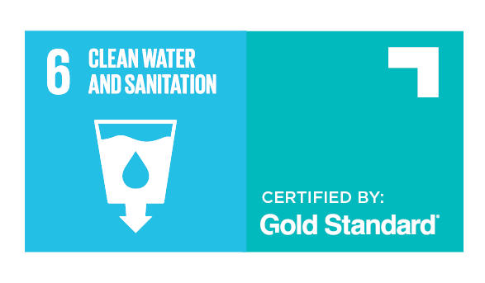
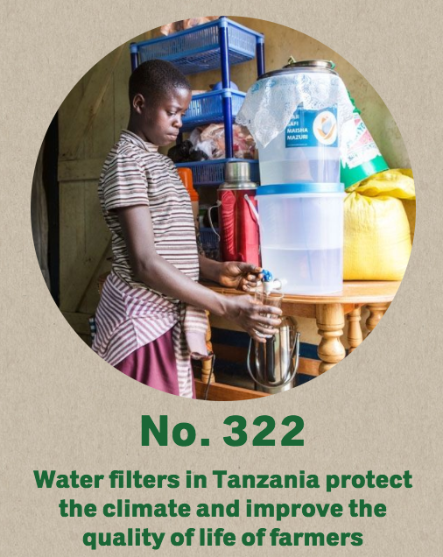

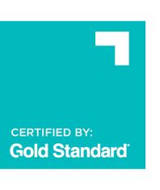

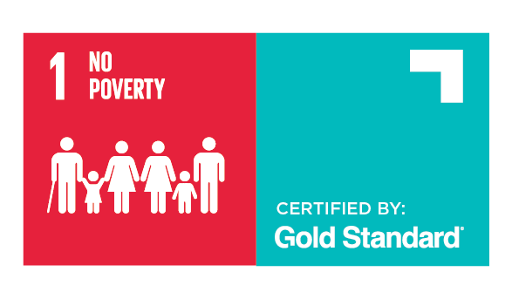
EXAMPLE:
“…we help the coffee farmers, who grow coffee for us, to more easily get clean drinking water. The project will avoid the emission of around 35,000 tonnes of CO2 and benefits the health and well-being of the local population.”

Slide 16
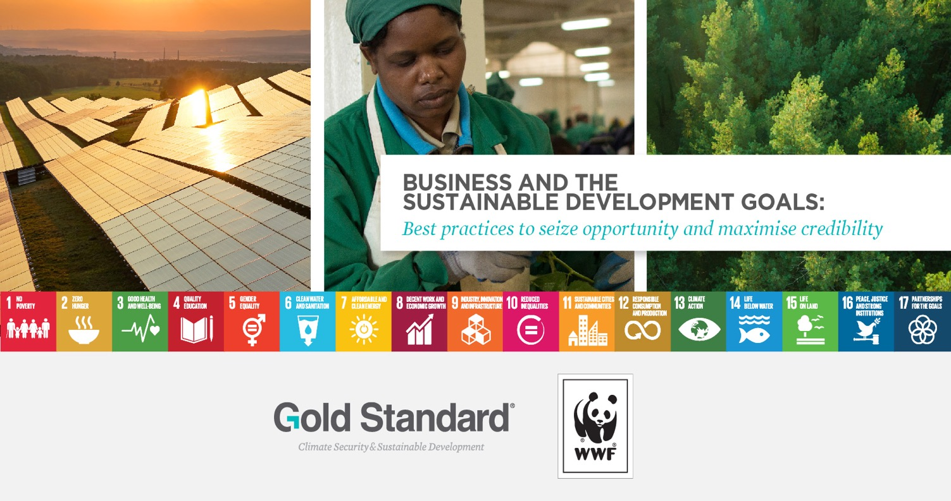

Slide 17

SDGs: COMMON CHALLENGES/PITFALLS
Reframing communications while maintaining business as usual
Internally-driven target setting
Leaving out negatives and trade-offs
Inconsistent reporting methods and indicators

Slide 18
BEST PRACTICES

Slide 19
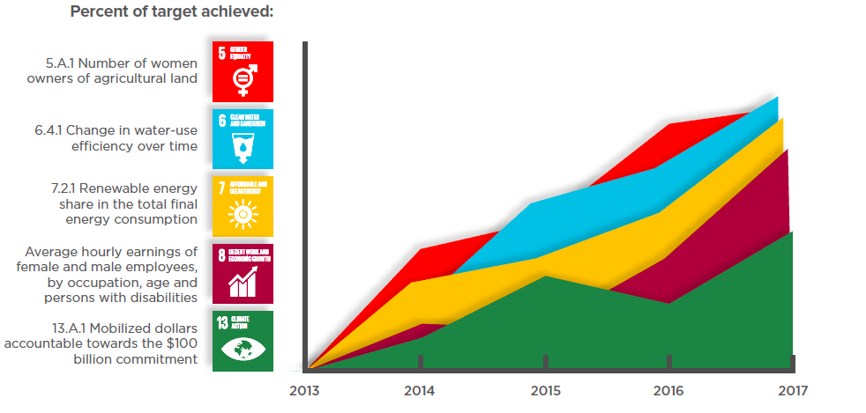
COMMIT TO COMPREHENSIVE IMPACT QUANTIFICATION + TARGET SETTING
Set ambition in line with best practice
Make sure negatives are part of the equation
Include value chain impacts
Involve relevant stakeholders in the process

Slide 20
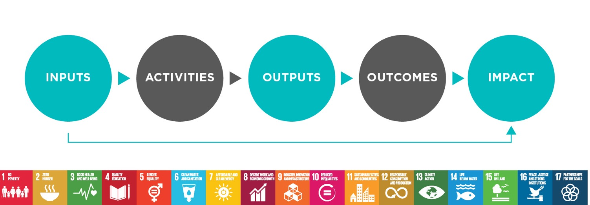
MOVE TO ASSESSMENT OF OUTCOMES + IMPACT

Slide 21
MAKE GOOD USE OF 3rd PARTY VERIFICATION
AND CERTIFICATION
Credibility from 3rd party assurance
Avoidance of ‘SDG washing’
Accuracy + comparability

Slide 22
EMBED SDG REPORTING INTO DECISION MAKING
Leverage new tools:
  SDG Compass
  PWC’s Global Business Navigator
  Natural Capital Protocol / Social Capital Protocol
Consider new products and services designed to contribute to specific SDGs or to reduce negative externalities
Embed sustainability targets into employee objectives and performance indicators

Slide 23
A TOOL TO ACCELERATE PROGRESS

Slide 24

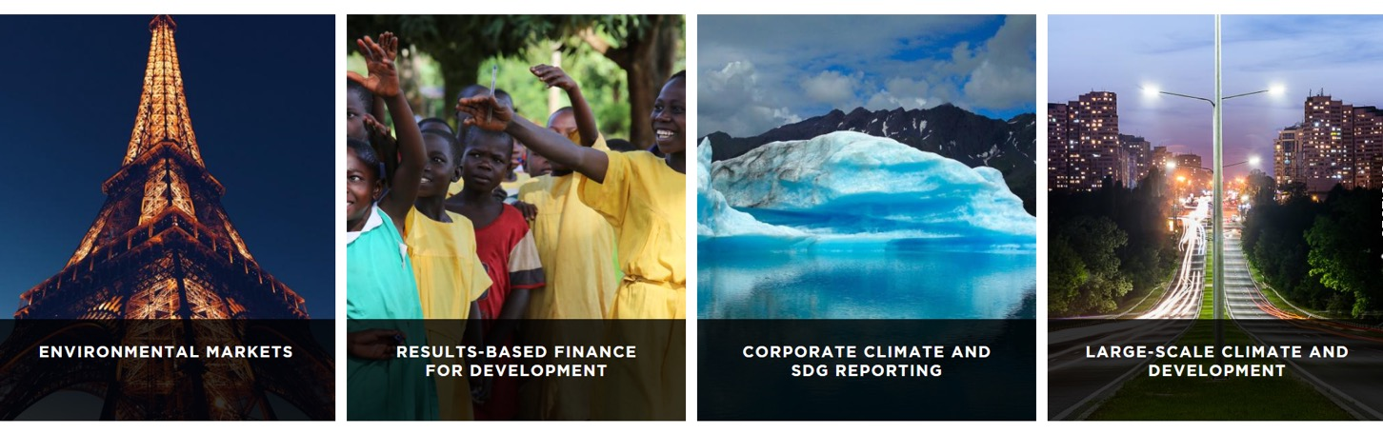
A next-generation standard to quantify, certify and maximise impacts
toward climate security and sustainable development

Slide 25

CUSTOMISED CERTIFICATION PATHWAYS
OBJECTIVE:
Credible impact reporting
GS-approved
impact methodologies
Principles + requirements
Environmental + social safeguards
Stakeholder inclusivity
Activity
requirements
SDG tools
Contributions to minimum 3 SDGs
Ongoing monitoring + reporting
OBJECTIVE: Monetise
impacts
Third party verification
OUTCOME:
Gold Standard Certified SDG Impacts
Product requirements to meet market needs
Third party verification
OUTCOME: Products for environmental markets or results-based finance
Demonstrate best practice
De-risk project + investments
Maximise impact
OPTIONAL
Notes:
Mandatory
Certification for reporting purposes:
Design level
Performance level
optional
Certification for monetisation purposes:
Results-based payments
Environmental markets

Slide 26

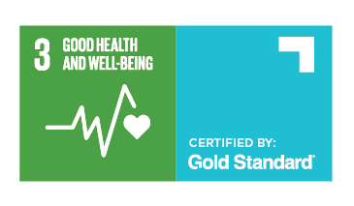
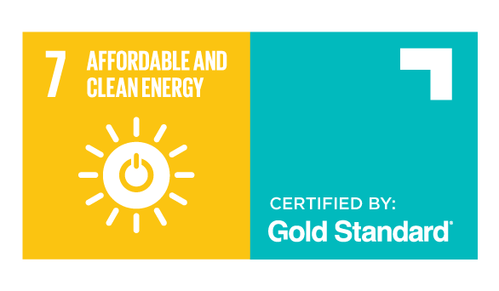

CERTIFIED SDG IMPACTS
Notes:
Renewable energy
Differentiators
Ensure that finance goes directly to the generation of new renewable energy
Only from high quality projects with robust safeguards, stakeholder inclusivity
Contributions to SDGs
Water safeguards
Enhanced safeguards at the project design level, enabling relevant projects to be labeled “water aware.”
Water Benefit Certificates
Gold Standard Certified SDG Impacts quantifying the water purified, supplied or conserved
Sustainable Sugarcane Initiative
WASH
ADALYs
Averted Disability-Adjusted Life-Years, a unit for measuring health impact, representing the years attributed to premature death or disability due to a certain health impact. Effective in assessing the global burden of disease.
Gender safeguards
Enhanced safeguards at the project design level, enabling all projects to be labeled “gender sensitive.”
Certified SDG Impacts
New methodologies in development to quantify and certify impacts, potentially:
Women’s economic empowerment
Reduction in time poverty
Women’s voice and agency
LARGE SCALE DEVELOPMENT
Project-only certification to de-risk investment and provide credible data for reporting purposes. APPLICATIONS:
Sustainable Urban Development
Green infrastructure
Development/Social Impact Bonds

Slide 27
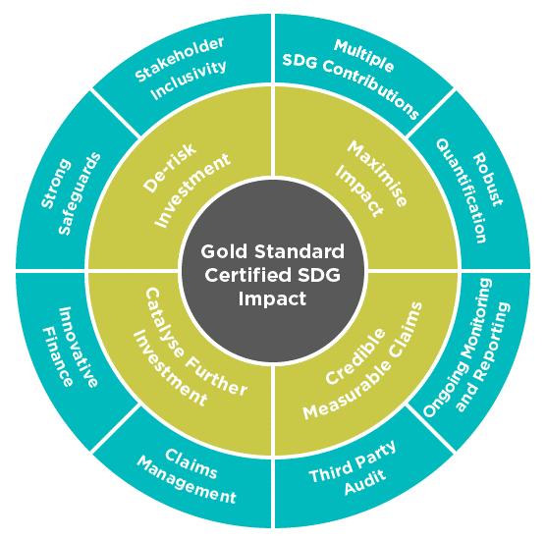
THE VALUE OF CERTIFIED SDG IMPACTS

Slide 28
ROUNDTABLE DISCUSSIONS
>> 3 CHALLENGES
>> 3 SOLUTIONS
FINANCE the global transition to a zero-carbon resilient economy
ADVOCATE for strong policy frameworks
REDUCE climate impact + risk in line with science
MEASURE + DISCLOSE climate impact and risks
Corporate
climate
leadership
Best practices for SDG strategy
Commit to comprehensive quantification of impacts (including negatives) and target setting in line with what’s needed to achieve the SDGs
Make good use of third party verification and certification
Embed SDG quantification and reporting into internal decision making

