Slide 1
Gold Standard Grow to Zero
April 19, 2018
"Finance Beyond": How companies can use markets to reduce emissions + contribute to sustainable development
Kelley Hamrick
Program Manager
Forest Trends’ Ecosystem Marketplace
Notes:
Thank you to the Gold Standard in general for letting me speak today.
For those of you who don’t know me, my name is Kelley Hamrick and I am the Program Manager of Forest Trends’ Ecosystem Marketplace Initiative. Today I am going to share data around corporate climate action, how that relates to offsets, the profile of a “typical” offset buyer and the current state of the supply and demand in the voluntary markets.
It’s a lot of ground to cover, so I’m going to try my best to stay within the 20 minute mark

Slide 2
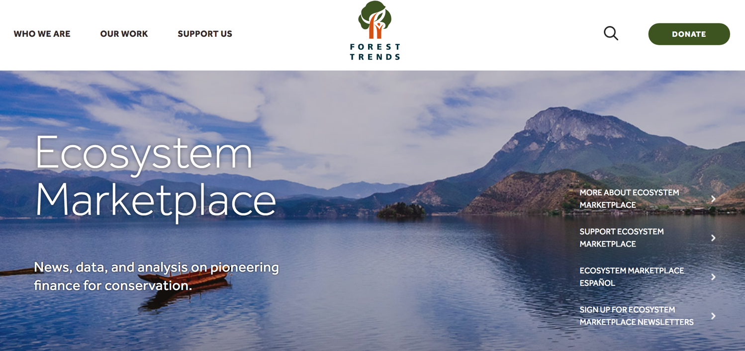
INTRO SLIDE
www.ecosystemmarketplace.com
Notes:
In case you aren’t familiar with Ecosystem Marketplace, we are an information provider about ecosystem markets. We produce reports, newsletters and articles about activity in these areas. I also wanted to add that we have finally updated our website, so I would encourage you to check it out!
I think most of you in this room are familiar with our voluntary carbon market reports, which track the volume and price of offsets transacted on the voluntary markets; while we usually produce those annually, we are trying something new this year with a Quarterly Periodical due out in late May. If you haven’t yet shared data with my colleague Melissa, please do so!

Slide 3
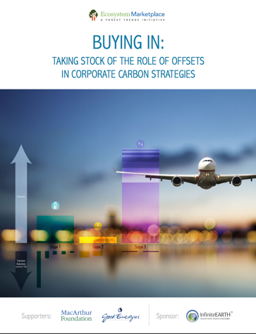
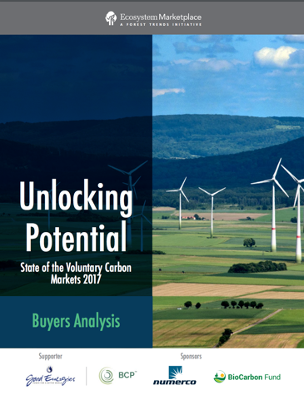
Outline:
How do companies currently reduce emissions?
What role does offsetting play in these activities?
How does offsetting relate to sustainable development?
Notes:
So I mentioned we produce reports – my presentation today will rely on data collected from two different sources:
The first is data collected through the CDP climate report. We have produced two historical reports that examined this corporate climate activity – our latest report was Buying In: Taking Stock of the Role of Offsets in Corporate Carbon Strategies that was released in 2016. I’m excited to say that we just received CDP’s latest data – which is from 2016 – and will be producing a new version of this demand-side study. The benefit with this survey is that the buyers are directly reporting to it; the downside is that we can only analyze questions that CDP has asked in their survey.
Additional data will come from our annual survey on the voluntary carbon markets. In 2017, we produced a spin off to our global State of the Voluntary Carbon Markets 2017 report; this mini-report looked at buyer activity in more detail than previously. However, please note that this data is collected from suppliers; so it is suppliers giving us data about their buyers.

Slide 4
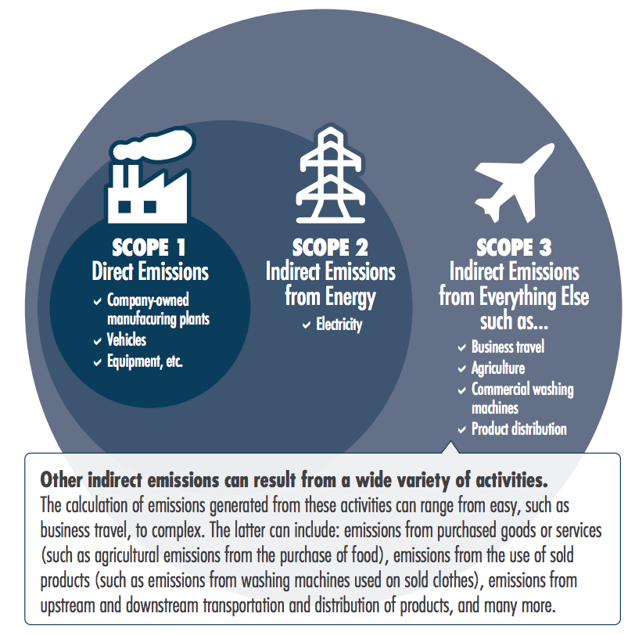
How do companies reduce emissions?
Measure
Notes:
Okay, so diving right in. I’m sure most in the room are familiar with this but I wanted to go over the steps companies take before offsetting.
This is a simplified view that we have – I’m sure there are those in the room who would argue for the addition of other necessary steps.
So step 1; Measure their emissions. Typically, most companies measure all of their scope 1 and 2 emissions; however, companies often vary in counting their scope 3 emissions.
For example, Ashley from Mars mentioned yesterday, that they are covering the entirety of their scope 3 emissions – including those from commodities. This is an exception rather than the rule.

Slide 5
How do companies reduce emissions?
Measure
Set a target (intensity-based or absolute)
Notes:
Companies then typically set a target to reduce their emissions. This can be done by setting an absolute or intensity-based target; the latter usually allows companies to increase their overall emissions but tries to slow down the overall pace of emissions.
We also heard yesterday about a few of these initiatives –
One is the Science based targets, which require companies to set targets around their emissions in line with the ambition needed to keep global temps below a 2 degree rise in Celsius. Right now, 380 companies have signed on.
There are also a number of US companies that have signed the We are Still In declaration, which pledges to uphold America’s commitments as part of the Paris Agreement. It’s a little weak on the specifics, but another initiative, called America’s Pledge, aims to tally these emissions reductions into a US-wide number. That report should be out later this year, and we are very interested in seeing it!

Slide 6
How do companies reduce emissions?
Measure
Set a target (intensity-based or absolute)
Reduce (voluntary or mandatory)
Notes:
Companies then take steps to reduce their emissions – this can be done to be in compliance with a government regulation or can be a voluntary action. Many companies also set a price on carbon, to help them incorporate carbon into their financial decisions.

Slide 7
How do companies reduce emissions?
Measure
Set a target (intensity-based or absolute)
Reduce (voluntary or mandatory)
Offset (voluntary or mandatory)
Notes:
And then – finally – companies can offset the emissions they can’t reduce. Likewise, this can be done for compliance purposes or for voluntary purposes

Slide 8
What have companies reported doing?
1,923 companies disclosed climate action to CDP in 2016.
Notes:
Okay so moving onto the CDP data!
One big caveat - I have only just received this data last Friday, so the analysis (and numbers you see here) are NOT finalized. Take it with a grain of salt.
In 2016, nearly 2000 companies disclosed climate activity to the CDP

Slide 9
What have companies reported doing?
1,923 companies disclosed climate action to CDP in 2016.
1,560 (81%) companies did not originate or purchase offsets in 2016.
363 (19%) companies did originate or purchase offsets in 2016.
Notes:
Most, as you can see, do not engage in offsetting.
One quick note on terminology – CDP asks companies if they buy or originate offsets.
So companies that “offset” – shown in dark blue here – can represent those that originate or buy offsets, either for voluntary or compliance purposes.
Still not a whole lot.

Slide 10
Set a target:*
1,054 companies have set an intensity target.
951 companies have set an absolute target.
429 companies have set a renewable energy
consumption and/or production target.
322 companies have not set any climate
reduction target.
*Note: Not all numbers add up to 1,923 companies, as not all companies responded to all questions.
Notes:
So what are they doing to address climate change?
Some companies went above and beyond and reported multiple targets. In general, however, nearly an equal amount reported setting an absolute or intensity target.

Slide 11
Set a target:*
1,054 companies have set an intensity target.
951 companies have set an absolute target.
429 companies have set a renewable energy
consumption and/or production target.
322 companies have not set any climate
reduction target.
53% versus 43%
45% versus 52%
19% versus 28%
19% versus 06%
*Note: Not all numbers add up to 1,923 companies, as not all companies responded to all questions.
Notes:
This looks a little different if we compare the actions of those companies that offset and those companies that don’t
Remember, companies that offset are in dark blue – this will show up a lot in the next few slides.
So 52% of the 363 offsetting companies have an absolute target; compared with 45% of the 1,560 companies that don’t offset.
Can see here that companies that offset are more likely to have an absolute target, and a renewable energy target. And hardly any had no reduction target – compared to 19% of companies that don’t offset.

Slide 12
Set a Science-Based Target:
215 companies intend to set an SBT in two years.
169 companies do not intend to set an SBT in two years.
105 companies’ targets have not yet been
approved as science-based by the SBT initiative.
49 companies have not set a science-based target
as there is no methodology for their sector.
46 companies have set targets approved as
science-based by the SBT initiative.
Notes:
This looks a bit more closely at companies with absolute targets – this shows the # of companies that have set, or plan to set a science based target.
More companies intend to set one than currently have

Slide 13
Set a Science-Based Target:
215 companies intend to set an SBT in two years.
169 companies do not intend to set an SBT in two years.
105 companies’ targets have not yet been
approved as science-based by the SBT initiative.
49 companies have not set a science-based target
as there is no methodology for their sector.
46 companies have set targets approved as
science-based by the SBT initiative.
10% versus 11%
09% versus 06%
05% versus 05%
02% versus 04%
02% versus 03%
Notes:
And you can see…
Not much difference in the numbers here, but you can see there is a slight increase in the number of offsetting companies that intend to set an SBT in the next two years, or have targets approved by SBT inititive.

Slide 14
Have a price on carbon:
440 companies have a price on carbon.
1,155 companies do not have or plan to
have a price on carbon in the next two years.
315 companies do not have a price on carbon,
but plan to implement one in the next two years.
Notes:
Price on carbon – 440 have set a price, and 315 intend to

Slide 15
Have a price on carbon:
440 companies have a price on carbon.
1,155 companies do not have or plan to
have a price on carbon in the next two years.
315 companies do not have a price on carbon,
but plan to implement one in the next two years.
65% versus 31%
17% versus 11%
17% versus 33%
Notes:
Can see here that companies that offset are more likely to have a price on carbon

Slide 16
Invest in emissions reductions activities:
$260.7 Billion: the total value companies reported making in emissions reduction investments.
Often, investments targeted emissions reductions across scopes:
$201.2 Billion in Scope 1 activities
$15.7 Billion in Scope 2 (location-based) activities
$9.5 Billion in Scope 2 (market-based) activities
$65.4 Billion in Scope 3 activities
Notes:
Finally, companies reported investing $260.7B in internal emissions reductions activities
Typically in scope 1 activities, and a bit in scope 3 activities

Slide 17
Invest in emissions reductions activities:
$260.7 Billion: the total value companies reported making in emissions reduction investments.
Often, investments targeted emissions reductions across scopes:
$201.2 Billion in Scope 1 activities
$15.7 Billion in Scope 2 (location-based) activities
$9.5 Billion in Scope 2 (market-based) activities
$65.4 Billion in Scope 3 activities
$127.8B vs $132.9B – despite offsetting companies making up only 19% of all companies reporting to CDP.
46% versus 54%
89% versus 11%
76% versus 24%
51% versus 49%
Notes:
Offsetting companies are punching well above their weight – especially with investments in Scope 1 & 3 activities!

Slide 18
On average, companies that purchase or originate offsets are more likely to set an absolute target, implement a price on carbon, and invest in internal emissions reductions activities than companies that do not purchase or originate offsets.
Notes:
So I know that was a lot of figures
But all of this is to say that we see companies that offset (either purchase OR originate, remember) are more likely to set an absolute target, implement a price on carbon and invest more in internal emissions reductions activities… and all this on top of either producing offsets or buying them

Slide 19
This matches what we tracked in 2014 CDP data:
Companies that offset are not “buying their way out of their obligations”. They are much more actively addressing climate change.
Notes:
This matches what we found in the previous CDP offsetting report we did, which analyzed 2014 CDP data
Then, we saw offsetting companies spend 10x more on average on emissions reductions activities than the typical companies that doesn’t offset.

Slide 20
Who is the typical voluntary offset buyer?
Notes:
So who is the typical offset buyer?
I’m switching now to data we collected in last years SOVCM survey
Remember this is buyer data collected from suppliers
And this is only VOLUNTARY market data

Slide 21
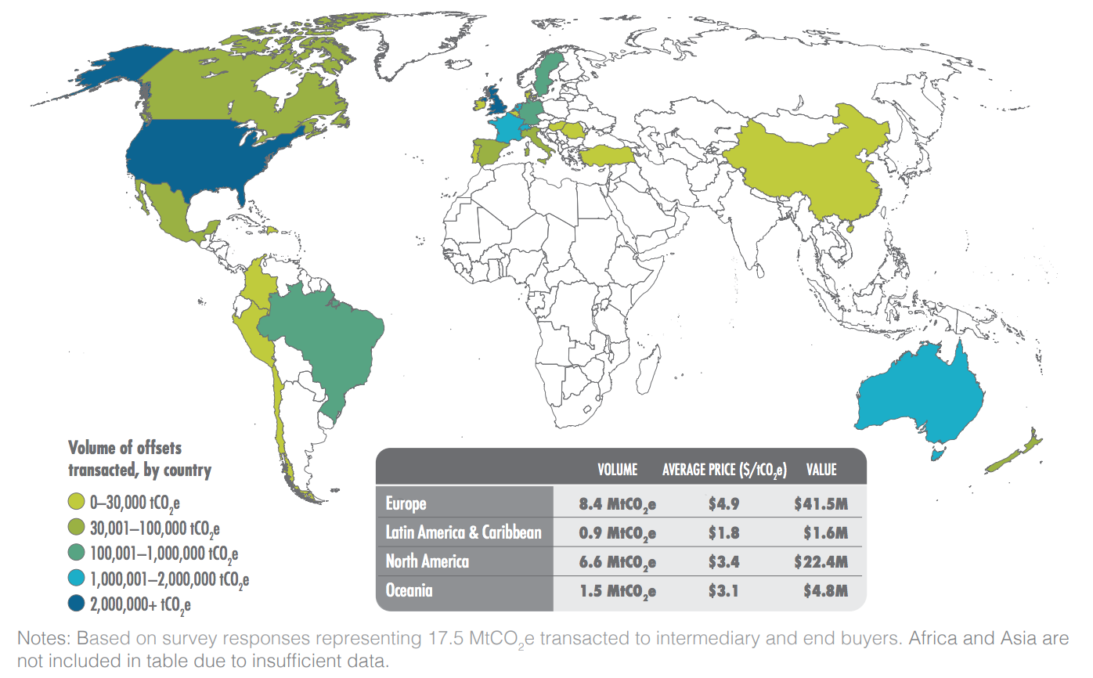
Buyers are primarily located in North America and Europe.
Market Size by Project Region and Country, 2016
Notes:
Where are buyers located?
Most of the demand for voluntary offsets came from Europe and North America – almost half came from Europe and almost 40% was from North America.
The biggest buyers by volume were the US, UK, Australia, Germany, France, and the Netherlands

Slide 22
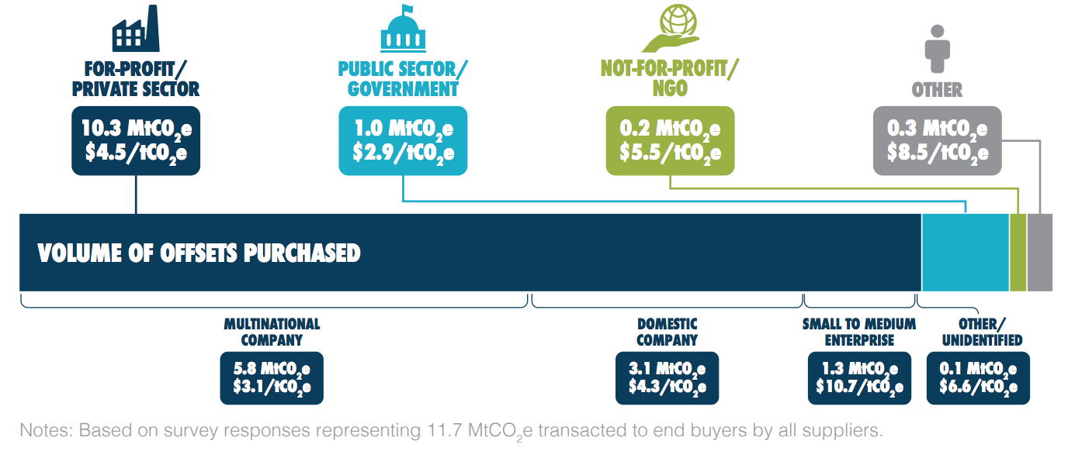
Most buyers are for-profit companies.
Buyers by Volume and Price, 2016
Notes:
Who is buying offsets?
For-profit/private sector companies were the buyers in the bulk of offset sales by volume (88%), value (88%), and count of transactions (61%), followed by governments, non-profits, and finally 'other' which was mainly individuals.
Within the for-profit/private sector category, larger companies tended to purchase higher volumes of offsets at lower prices than smaller companies.
There is a real difference in average prices – multinationals paid an average of 3.1 US dollars, domestic companies paid 4.3, and small to medium enterprises paid 10.7 (over three times as much as multinationals.
This generally held true across different regions and offset types.

Slide 23
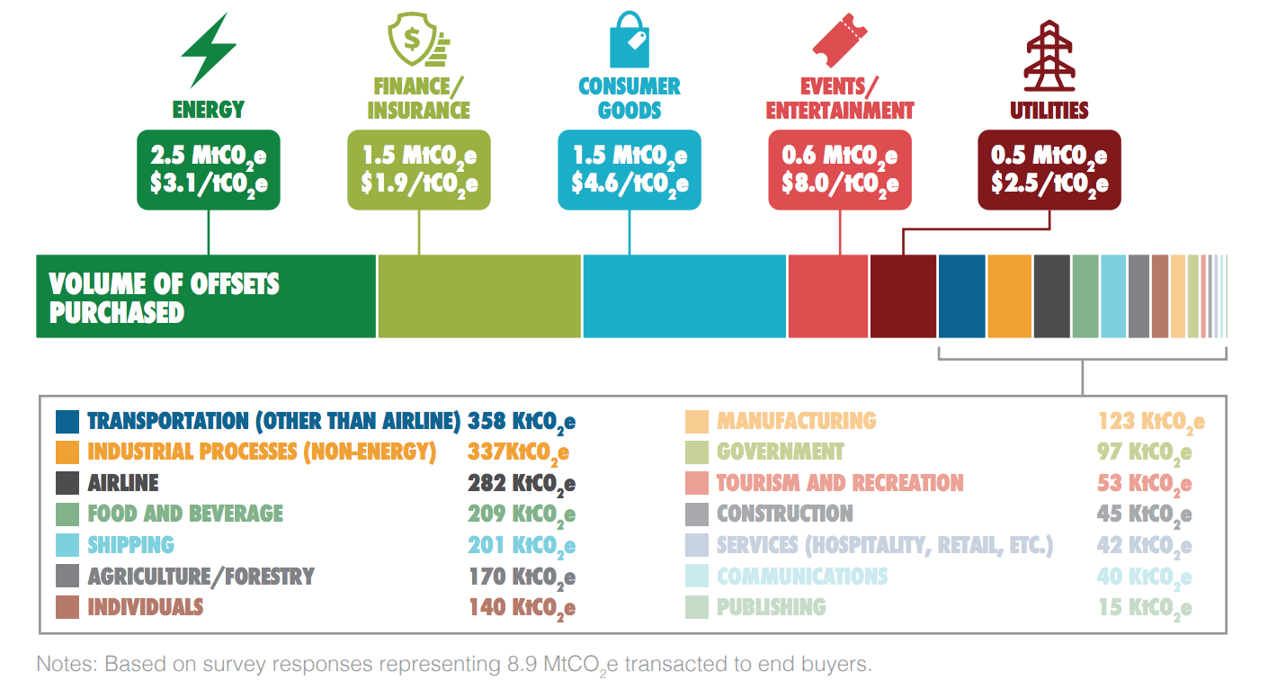
They typically represent energy, finance and consumer goods sectors.
Volume of Offsets Purchased and Average Price Paid by Buyer Sector
Notes:
Drilling down a little deeper into what types of organizations are buying offsets.
The top five sectors purchased 75% of the total offsets sold to end buyers. Buyers in the energy sector category purchased the highest volumes of offsets (29%), followed by buyers in the finance/ insurance (17%), consumer goods (17%), events/entertainment (6%), and utilities (6%) sectors.
Even though those were the biggest, offset buyers really represented a huge range of sectors.
Transportation was another big one – we broke transportation out into airlines and non-airlines, but combined they represented about 7% of the overall volume purchased.
Another notable sector was education. We got several write-in responses in the 'other' category listing buyers in education – mainly colleges and universities.

Slide 24
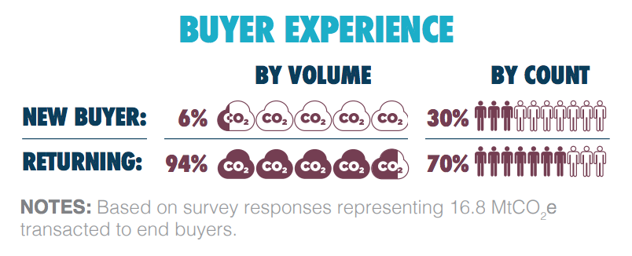
New buyers typically start with small purchases.
Market Volume and Transactions by Buyer Experience, 2016
Notes:
First, have buyers purchased offsets on the voluntary market before? As you can see in the top chart there, we looked at it both by the volume of offsets purchased and the count of transactions.
Most end buyers have purchased carbon offsets in the voluntary market before – as you can see, returning buyers accounted for almost all (94%) of the volume of the total offsets.
Buyers new to the market purchased just 6% of the volume, but they conducted almost a third (30%) of 2016 transactions by count. Their average transactions were much smaller in size (about 40 KtCO2 e per transaction) than returning buyers (over 260 KtCO2 e per transaction).
Most were returning buyers, but new buyers did appear in Europe, Latin America and the Caribbean, and North America in 2016
New buyers from Latin America and the Caribbean purchased the highest percentage of offsets compared to other regions: over one-fourth (27%) of reported Latin America and the Caribbean buyers purchased their first offsets in 2016

Slide 25
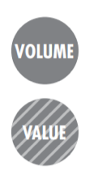
Buyers typically purchase to meet their GHG targets or to show climate leadership.
Climate
Leadership
Pursuit of
GHG Targets
Pursuit of Climate-
Driven Mission
Engage
Customers/Clients
Sustainable Supply
Chain Development
Promote Organization/
Staff Learning
Climate Change Affects
Business Model
Anticipation of
Direct Regulation
Notes:
the big question always is: why do buyers purchase offsets? They don’t have to, of course – that’s why we call it the voluntary market. So what do buyers get out of this?
For most buyers, there is no single answer; they have a multitude of reasons, some overlapping with each other.
However, we conduct a survey and so we had to ask about motivation in a survey-friendly way. We asked respondents to please choose the main reason from a list of options.
This slide shows the result.
Here you can see the 8 possible options respondents could select from, and the % of volume and value sold associated with them. Volume is the top bubble; value is the dashed bubble below.
The majority of buyers were interested in climate leadership; we tracked 30 transactions associated with this motivation. These buyers want to position themselves as climate leaders in their industry, as a way to differentiate their brand. They also led the way by paying the most per offset, at an average of $8.2/tCO2e.
We actually tracked more offsets sold to buyers pursuing GHG targets, but they paid an average of $3.9/t and so the total value was less. Of course, many companies might set up a GHG target in order to demonstrate climate leadership, etc…which goes to show how interlinked some of these are.
Following this, end buyers pursuing a climate-driven mission purchased 21% of all offsets, at an average price of $2.7/t
After that was organizations purchasing offsets as a way to engage customers and clients. While they purchased offsets at an average of $1.8/t, it is possible they resold those to consumers at a different price.
While we just discussed buyer motivation to offset, sometimes buyers are less interested in the carbon part of their offset and more interested simply supporting projects that are doing good for the world. According to survey respondents, buyers for whom co-benefits had “some” or “major” influence over their decision to enter the market purchased over half (58%) of offsets sold in 2016.
[make note that this is a separate question]

Slide 26
While demand is growing, the size of voluntary and compliance markets remains limited by offset demand – not offset supply.
Notes:
While demand is growing, the size of voluntary and compliance markets remains limited by offset demand – not offset supply.

Slide 27
Voluntary offset issuances AND retirements
hit a record high in 2017.
Notes:
This includes GS, VCS, CAR and ACR data
Just as a quick recap for those who are new to the market…
issuances are when an offset becomes an offset
retirments are when an offset is taken off a registry and should no longer be traded.
very exciting to announce that issuances reached record high last year… 62.4 Mt
And so did retirements!! 42.6 Mt

Slide 28
Offsets support more than just emissions reductions.
Notes:
This is NEW CDP data. I have only just received it last Friday, so all numbers are NOT finalized. Take it with a grain of salt.

Slide 29
More projects are issuing offsets in low and lower-middle income countries.
Notes:
Switching to some sustainable development implications
Showing only GS & VCS – we don’t have Plan Vivo on hand, ACR & CAR are primarily US bound
Uses world bank country classifications
Can see there was a big spike in offsets issued from low-income countries (orange)
And can see big spike in light green, lower middle income countries – first time (2017) that total volume there surpassed that of upper middle income countries

Slide 30
End buyers increasingly purchase from projects in low and lower-middle income countries.
Notes:
And
End buyers increasingly purchase from projects in low and lower-middle income countries.
Can see in the light green and the dark orange, that there is a growing trend over time for buyers to purchase from those countries

Slide 31
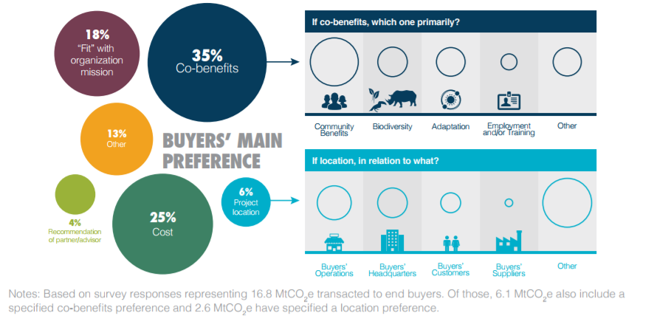
End buyers increasingly prioritize co-benefits with their purchase.
Share of Offset Volume by Buyer Preference When Choosing Offsets
Notes:
End buyers increasingly prioritize co-benefits with their purchase.
Buyers’ main concerns when purchasing offsets were co-benefits (35%), cost (25%), and “fit” with the organization’s mission (18%), followed by project location (6%) and recommendation of partners/advisors (4%), with “other” making up the remainder (13%)
Co-benefits of most interest were community development and biodiversity preservation (especially for forestry offsets from projects in Latin America and Africa). In contrast, buyers were more interested in adaptation benefits from renewable energy offsets in Asia.
We saw some price premium:
Buyers who prioritized cost paid an average of $2.1/t
Buyers who prioritized cobens paid an avg of $5.1/t
But lots of variation
In general, those who prioritize biodiversity paid $7.5/t;
While only $3.5/t for community benefits
Multi-national organizations were most concerned about cost (30%) but closely followed by co-benefits (27%)
Domestic corporations were generally more concerned with co-benefits

Slide 32
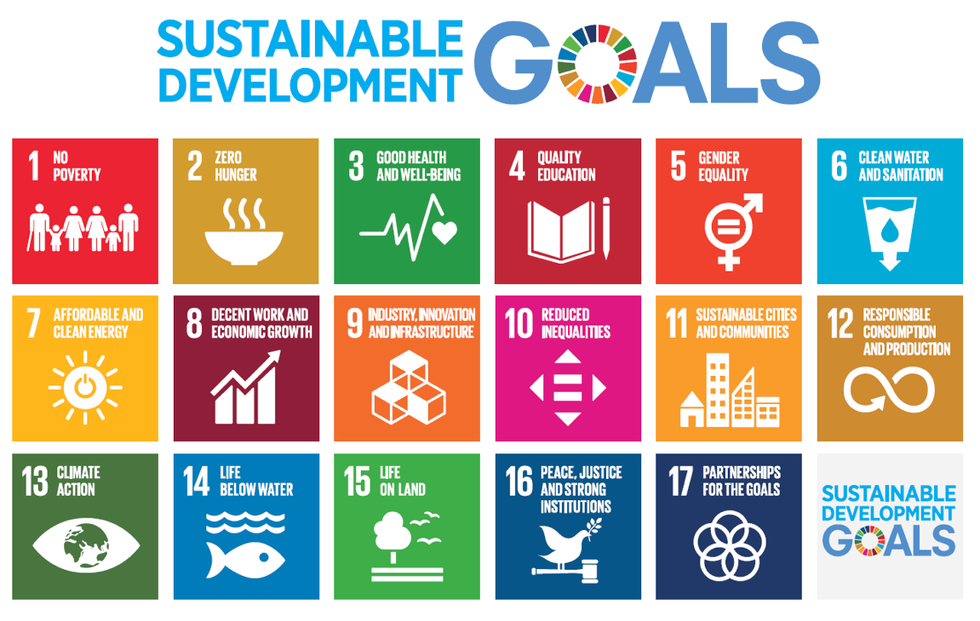
More sellers are aligning carbon offset projects with the Sustainable Development Goals.
Source: United Nations
Notes:
More sellers are aligning carbon offset projects with the Sustainable Development Goals.
Anecdotally, we’re seeing more sellers do this.
Not sure if buyers are actually making purchasing decisions around these goals.

Slide 33
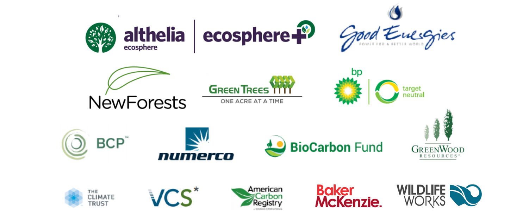
Thank you to our 2017 sponsors for making this work possible!
If you would like to support our upcoming Carbon Offset Insights Periodical or CDP-Buyers Report, please see me or email me at khamrick@ecosystemmarketplace.com.
Notes:
Thank you!
And thank you to our sponrsos last year who made this possible!

