Slide 1
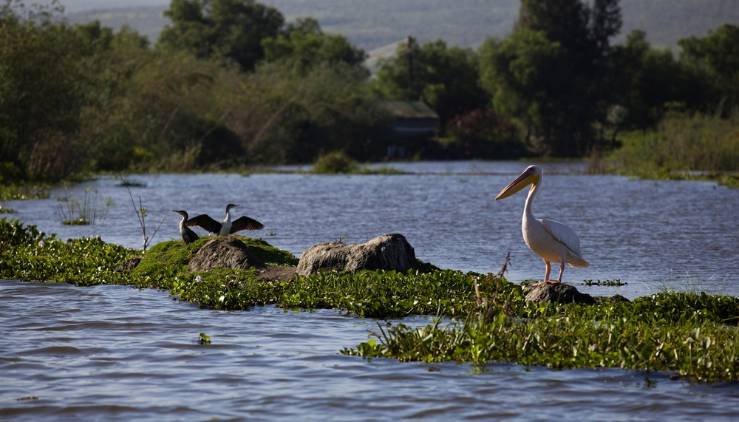
«Planting of trees is not a project, but our way of life. Please bring those trees…»
© WWF / Simon Rawles
Notes:
Two hotspots
Lake Naivasha is a freshwater lake in Kenya, outside the town of Naivasha north west of Nairobi. It is part of the Great Rift Valley.
Around 900,000 people live around the lake, https://benthamopen.com/FULLTEXT/TOFISHSJ-10-1
Kenya is the world’s third-largest horticulture exporter, accounting for one-third of all flowers imported into Europe. This booming industry is having a positive impact on the country’s economy and supports more than 500,000 jobs. Yet its impact on the environment is another matter entirely. Water is scarce and biodiversity is at risk due to intensive pesticide use and chemical runoff.
NGOs and environmental agencies have long expressed concern about the impact of irrigated flower crops on water resources. The region is home to some 2,000 ha of flowers, mostly in greenhouses, with producers taking water from Lake Naivasha and local groundwater reserves. As a result, the lake’s water level has dropped by several metres. In response, the industry has taken steps to try to protect this vital resource. Source: http://spore.cta.int/en/environment/lake-naivasha-under-threat.html

Slide 2
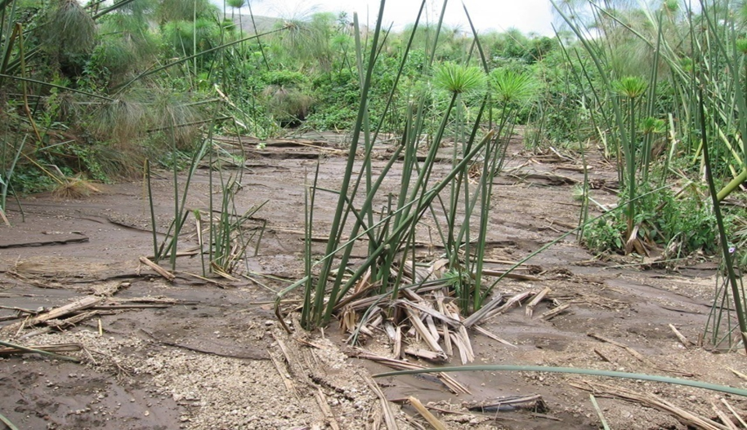
© WWF Kenya
Notes:
THREAT TO LAKE NAIVASHA
Population pressure
Resource use that come with flower production
Deforestation in the upper catchment leading to erosion and siltation
Illegal & excessive abstraction (both surface and groundwater) by farmers
Waste discharge from growing human settlements and farms
Increasing use of agro-chemicals in the upper catchment as soil productivity declines
Climate change and reductions in rainfall

Slide 3
Coop Insetting Approach:
Lake Naivasha Basin Reforestation
Project, Kenya
Goals:
To reforest 1,000 hectares of the Lake Naivasha basin over the next three years, to be managed for a minimum of 30 years, woodlots make up 42% and agro-forestry 58%, with 50/50 exotics vs local species
To improve the natural resource management capacity of participating farmers for the benefit of the whole community
To improve the livelihoods and water quality in the Lake Naivasha basin
Notes:
Coop approach: in-setting along its own supply chain

Slide 4
Coop Insetting Approach:
Lake Naivasha Basin Reforestation
Project, Kenya
Partners: up to 1,000 smallholder farmers (CFAs, WRUAs), Swiss retailer Coop and its suppliers of cut flowers, South Pole
Estimated emission reductions: total of 42,000 tons of CO2e
Timeframe: 2017-24 with first planting of 210 ha in April 2018.
Cost: roughly USD one million
Notes:
WRUAs: Water Resource User Associations – how many WRUAs? 9
CFAs: Community Forest Associations – how many CFAs? 2
Key role: organize, manage farmers, monitor and maintain plantings?

Slide 5
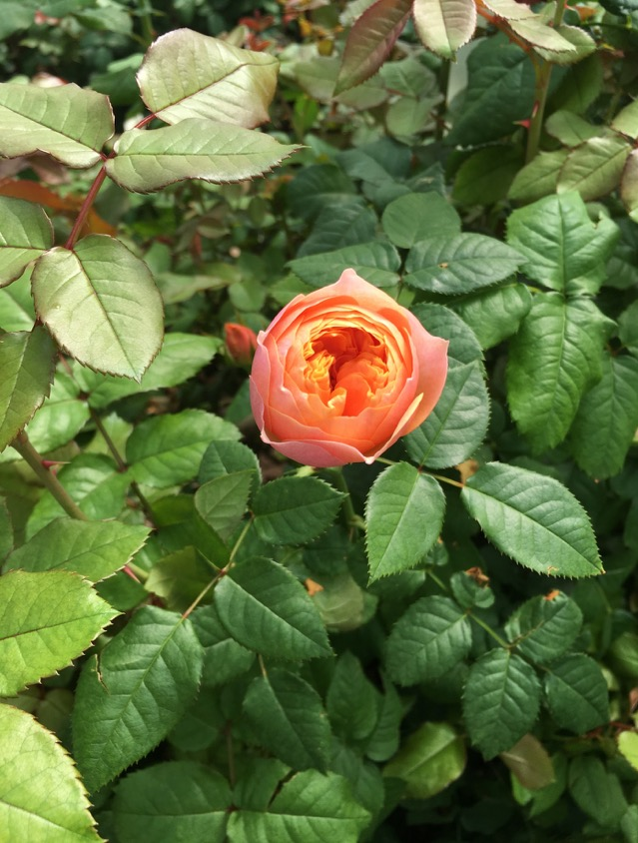
© WWF / Bella Roscher
Notes:
Partners
Innovative approach – taking resp within their supply chain and water stewardship approach by invesitng in the whole catchment areas
Value chain
Bringing offsetting close to ones value chain – integrating it
Stewardship
Taking a stewardship approach
Conservation
Linking conservation to this by working with WWF Kenya
Contributing to SDGs – comms to water security, employment, biodiversity
Photo: Bella Roscher, © WWF

Slide 6
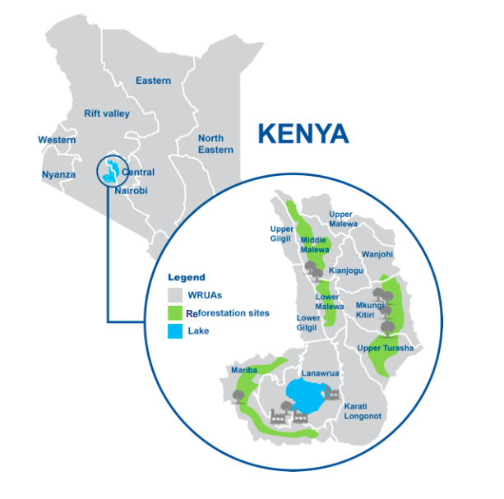

Slide 7
Design
Implementation
Monitoring
2017
Finalizing LSCs
2019
Reforest 540 ha
2020
Reforest 250 ha
Management of reforestation
monitoring
2020-2024
Management
Monitoring
Generate 42000 GS VERs
2024-2038
Management of reforestation
Monitoring
2018
Project design activities
Local stakeholder consultations
Farmer selection, mapping and training
Reforest 210 ha
Management of reforestation

Slide 8
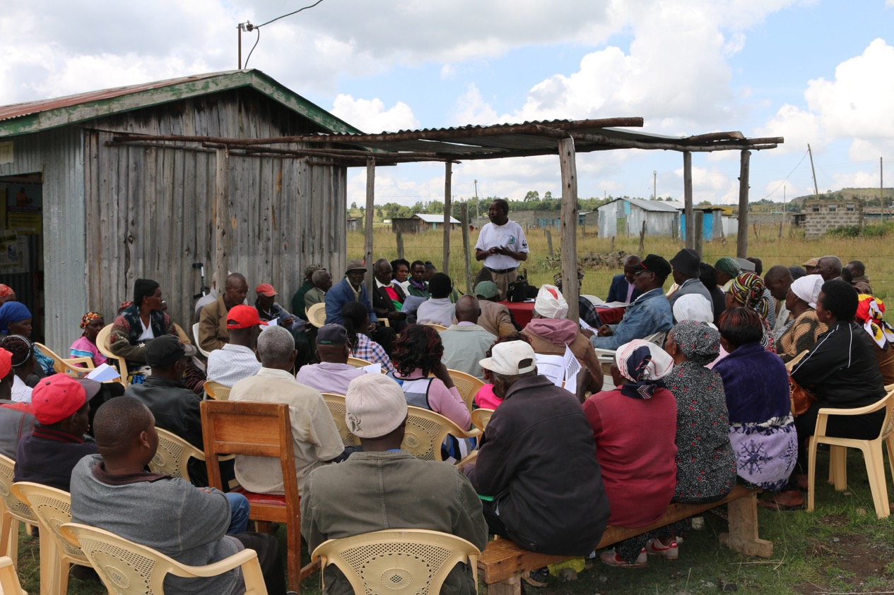
© William Garrett, South Pole
Notes:
12 Local Stakeholder Consultations carried out in Dec 2017 and Jan 2018. More than 1,000 people reached in total. Farmers made clear there is a lot of land available in the basin, which could be used for planting, including grazing land? Possible, zero grazing, cultivated land
LSC in Captain
Photographer: William Garrett © South Pole

Slide 9
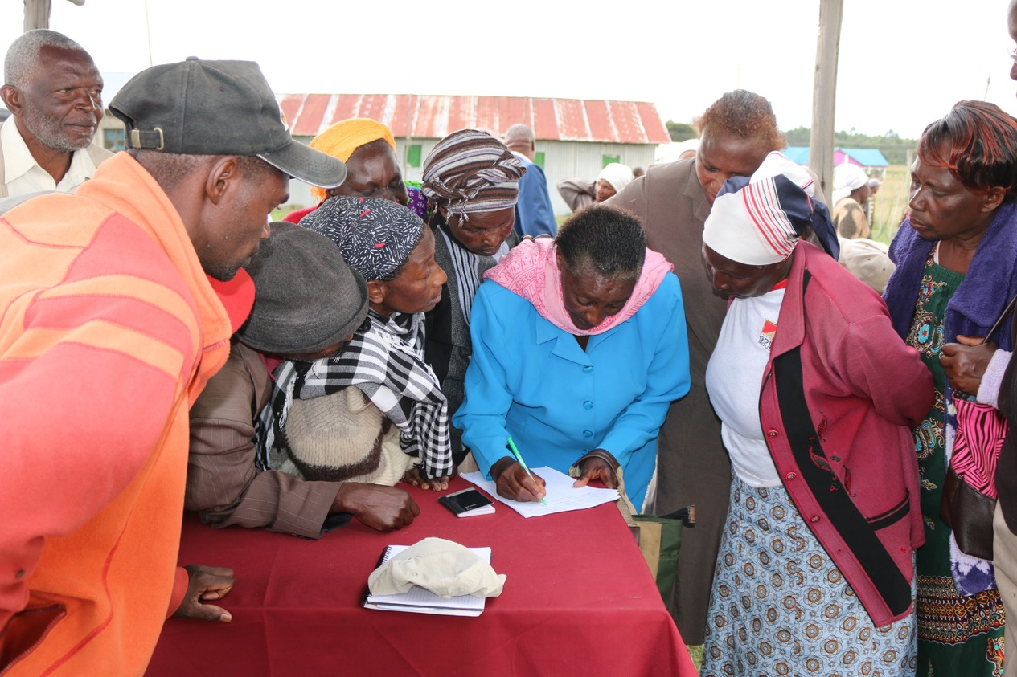
© William Garrett, South Pole
Notes:
LSC in Captain. Signing up for avocado seedlings
Photographer: William Garrett © South Pole

Slide 10
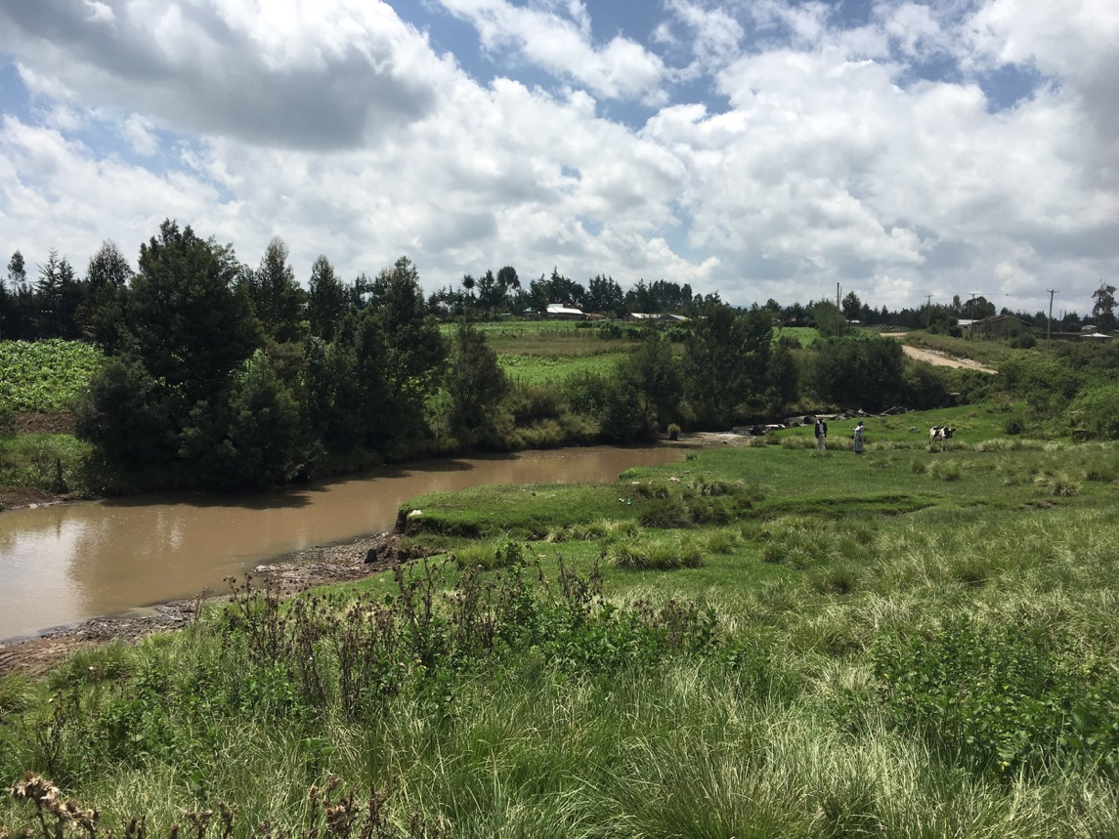
© WWF / Bella Roscher
Notes:
Tree planting will occur in buffer zones to be established along river banks, riparian zones, for water retention, wash out
Linking water protection with tree planting?
Cooperating with exisitng organizations
Photo: Bella Roscher, © WWF

Slide 11
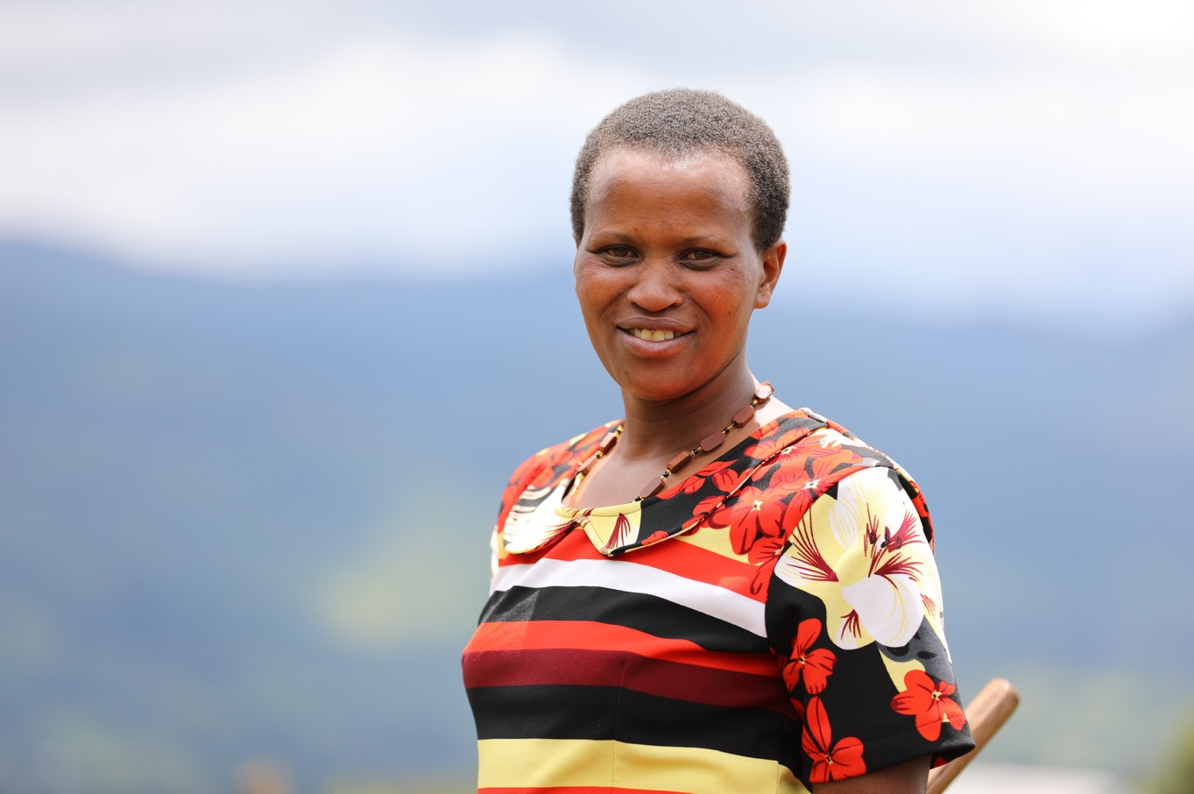
Anne Wanyoike Treasurer, Aberdare Community Forest Association:
“Our involvement in the project reaffirms our commitment to conserve the Aberdare Ranges, a critical water catchment, in fact one of the five main water towers in the country.”
© John Njoroge
Notes:
Ann Njoki, treasurer of Group 111 – what group is this, what does it do, and where? Is Ann a farmer?
Upper catchment, CFA gets user rights of existing forest areas, in collab with the KFS, which has extensive forest plantations, benefits include: allowed to grow crops (access to land), farming around seedlings, firewood
Photo: John Njoroge

Slide 12
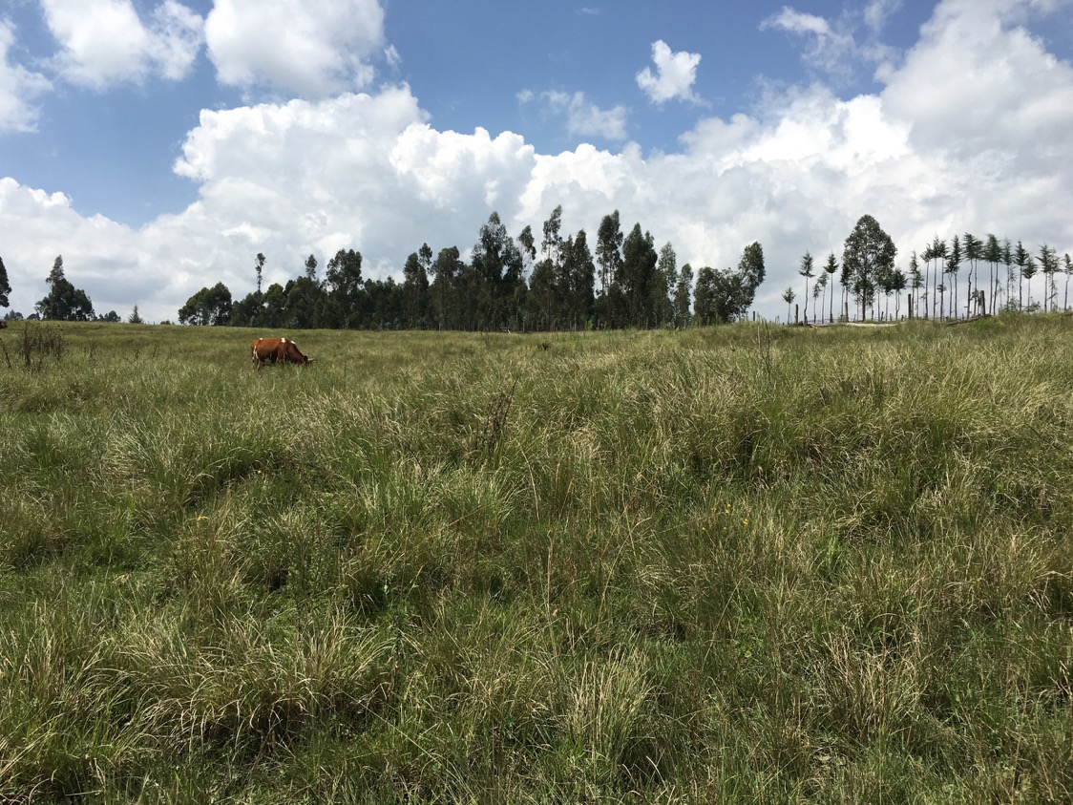
© WWF / Bella Roscher
Notes:
Land to be planted
Formerly cleared land
Photo: Bella Roscher, © WWF

Slide 13
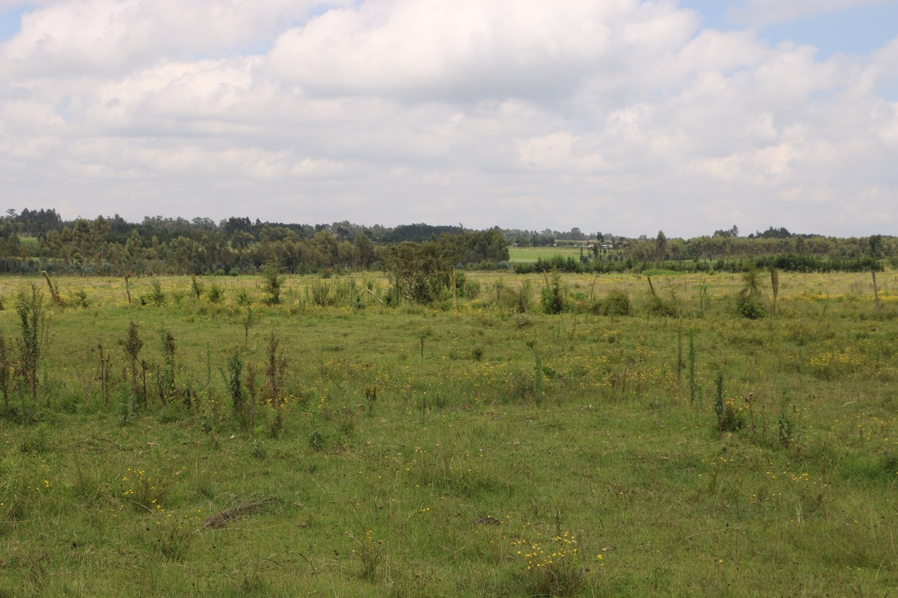
© WWF / Christian Som
Notes:
Land to be planted
Photo: Christian Som, © WWF

Slide 14
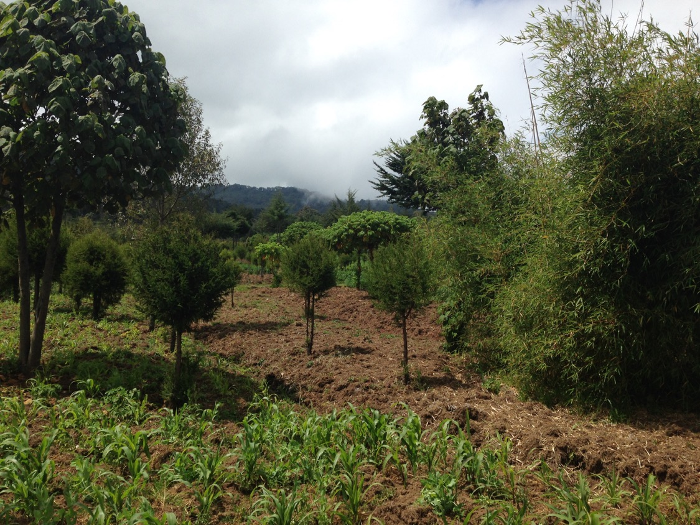
© WWF / Bella Roscher
Notes:
Where is this and what species? What is this an example of, agro-forestry?
Photo: Bella Roscher, © WWF

Slide 15
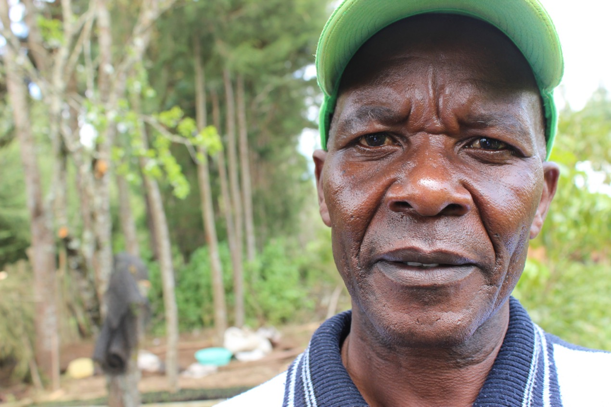
John Kihiu, Tree Nursery Manager:
“Improved tree cover will help improve biodiversity and communities will benefit from other forest products, such as bee keeping.”
© John Njoroge
Notes:
John and his wife have been managing a tree nursery for the past 15 years. From this business, he has been able to school three children and build a house. Through this project, he hopes to mentor community members to take up conservation as business. In the first phase of the project, John plans to plant 4500 pine seedlings.
Photo: John Njoroge

Slide 16
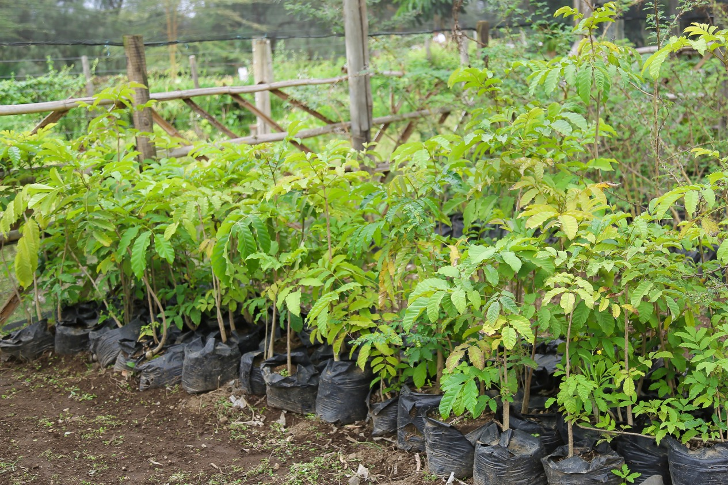
© John Njuguna Njeri
Notes:
Tree seedlings at the Flamingo flower farm, Naivasha.
Photo: John Njuguna Njeri

Slide 17
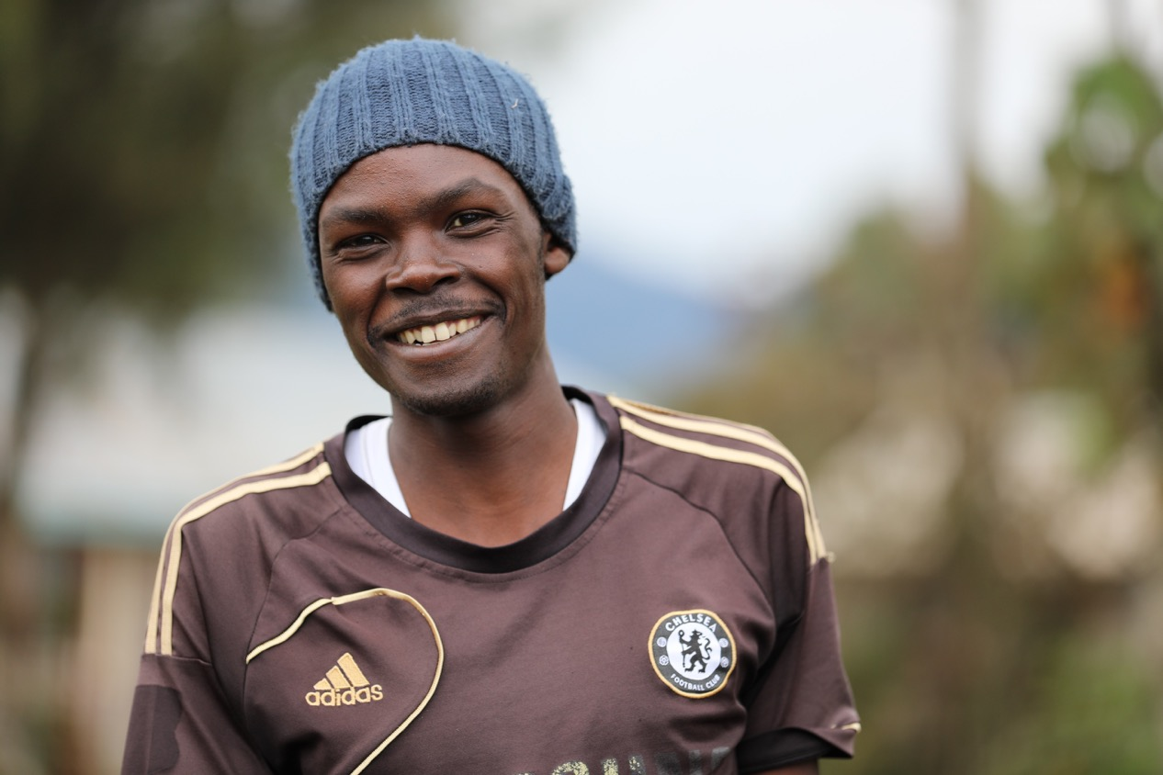
© John Njoroge
Notes:
Benson Mwangi, a caretaker at the tree nursery XX in XX and a member of the Upper Turasha Kinja WRUA said that, this engagement provides a learning and employment opportunity for women and youth. Mwangi who is a father of three adds that he plans to plant more trees at his home.
Photo: John Njoroge

Slide 18
© WWF Kenya
Notes:
Kenya has banned plastic bags, so not able to use plastic bags in the nurseries, must find alternative
Photo: WWF Kenya

Slide 19
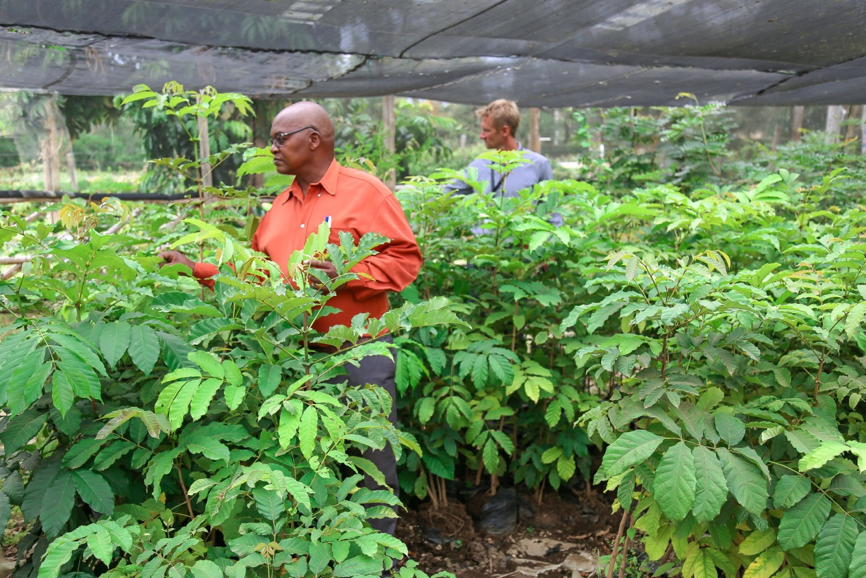
William Garrett, Project Manager, South Pole:
“Insetting combines offsetting with effective management of social and environmental resources in supply chains. It’s an innovate form of corporate climate action, sending a strong signal to all stakeholders.”
© John Njuguna Njeri
Notes:
John Mburu of Flamingo and William Garrett of SP checking tree seedlings at Flamingo nursery. «Engaging earlier, brings more value than a regular offsetting project.»
«Insetting combines carbon compensation with effective management of environmental and social resources in supply chains. It’s a great innovative form of corporate climate action, which sends a strong signal to all stakeholders.»
Photo: John Njuguna Njeri

Slide 20
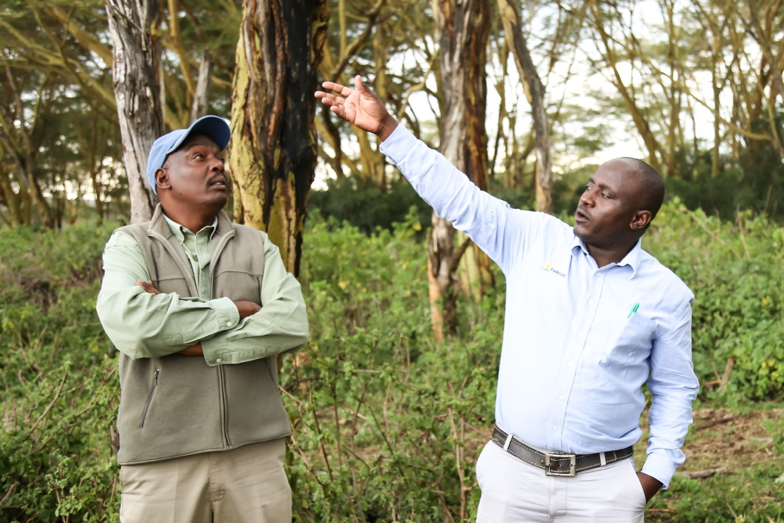
© John Njuguna Njeri
Notes:
John Ndegwa and Stephen Musyoka from the Oserian flower company, Naivasha, checking giraffe damage
Photo: John Njuguna Njeri

Slide 21
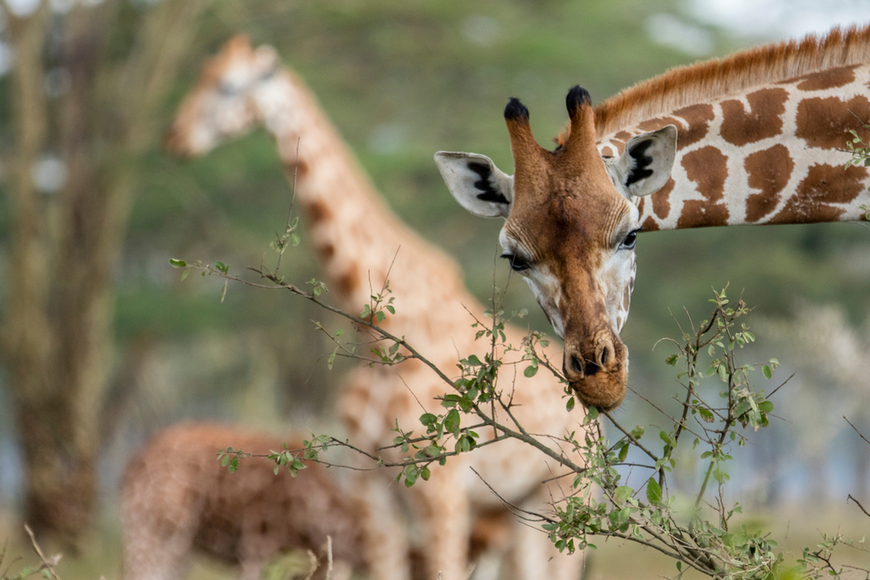
© WWF-US / James Morgan
Notes:
Growing giraffe population also a threat to remaining forest patches along the lake. Project partner Oserian will address this by protecting the remainig trees.

Slide 22
Challenges
The Lake Naivasha basin is very diverse regarding growing conditions, social structures, land use Obtain information from all parts of the basin and develop a wide range of tree planting systems to cover the diverse conditions
Potential community conflicts Active engagement with all community groups to create equal opportunities for participation in project
The Gold Standard requirements are sometime unclear Continuous dialogue with GS
The timing of unpredictable rains makes it hard to plan tree planting activities Prepare nurseries and farmers, so they can adapt to changing climatic conditions

Slide 23
Challenges (2)
Obtaining data from so many sites is only possible by training people to participate voluntarily Buy-in and training of community members to be involved in the monitoring.
Each participant requires individual site visits to ensure reforestation is in compliance with the GS Work through WRUAs and CFAs to engage with local communities to encourage them to support this process
Training required to ensure reforestation is implemented in a consistent manner Develop effective training programs and partner with other organizations, e.g. Kenya Forest Service

Slide 24
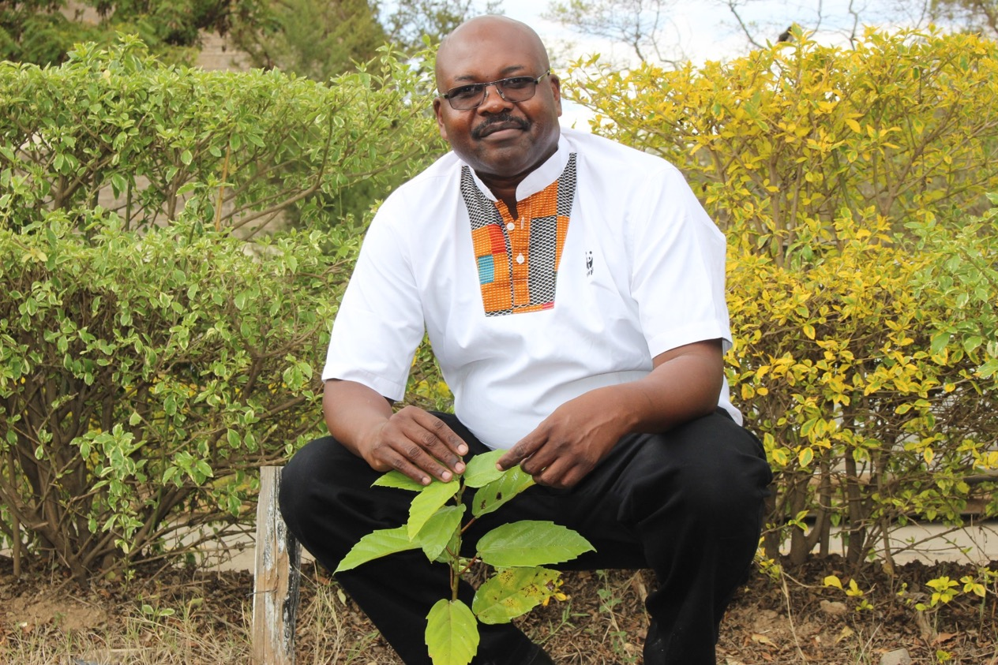
Dr William Ojwang, Programme Manager African Rift Lakes, WWF Kenya:
“The project is a great opportunity to protect key headwaters in the Naivasha basin by increasing tree cover, and to enable communities and WWF to combat global warming.“
© ?
Notes:
Photo: ?

Slide 25
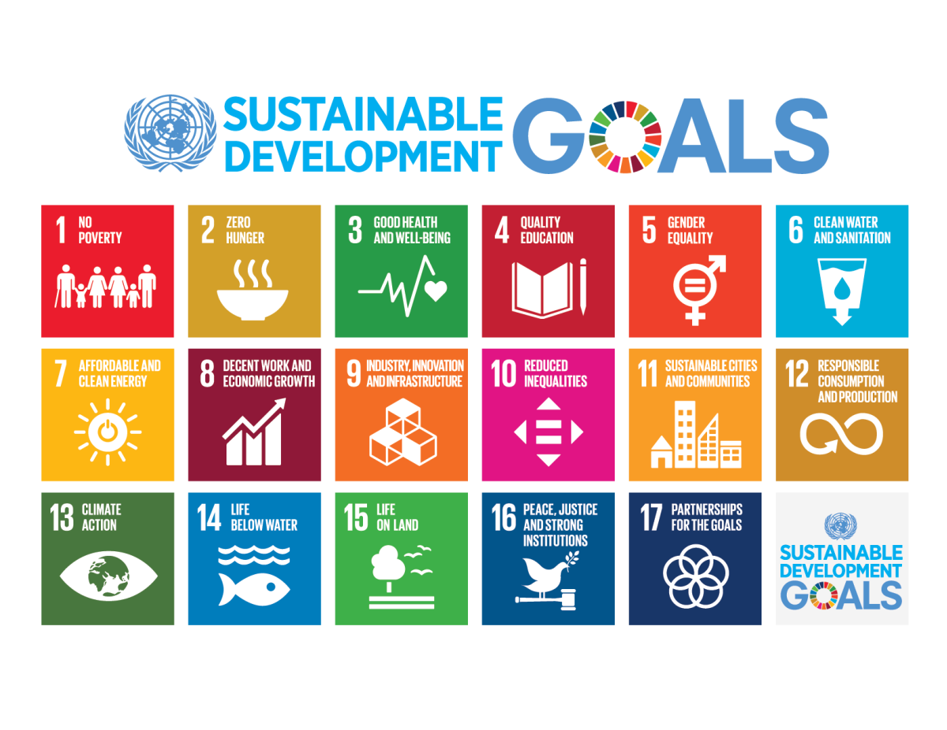
Notes:
Take home message:
Responsible and Innovative approach to their cut flower supply, Coop is contributing to SDGs 6, 9, 12, 13, 15

