Slide 1
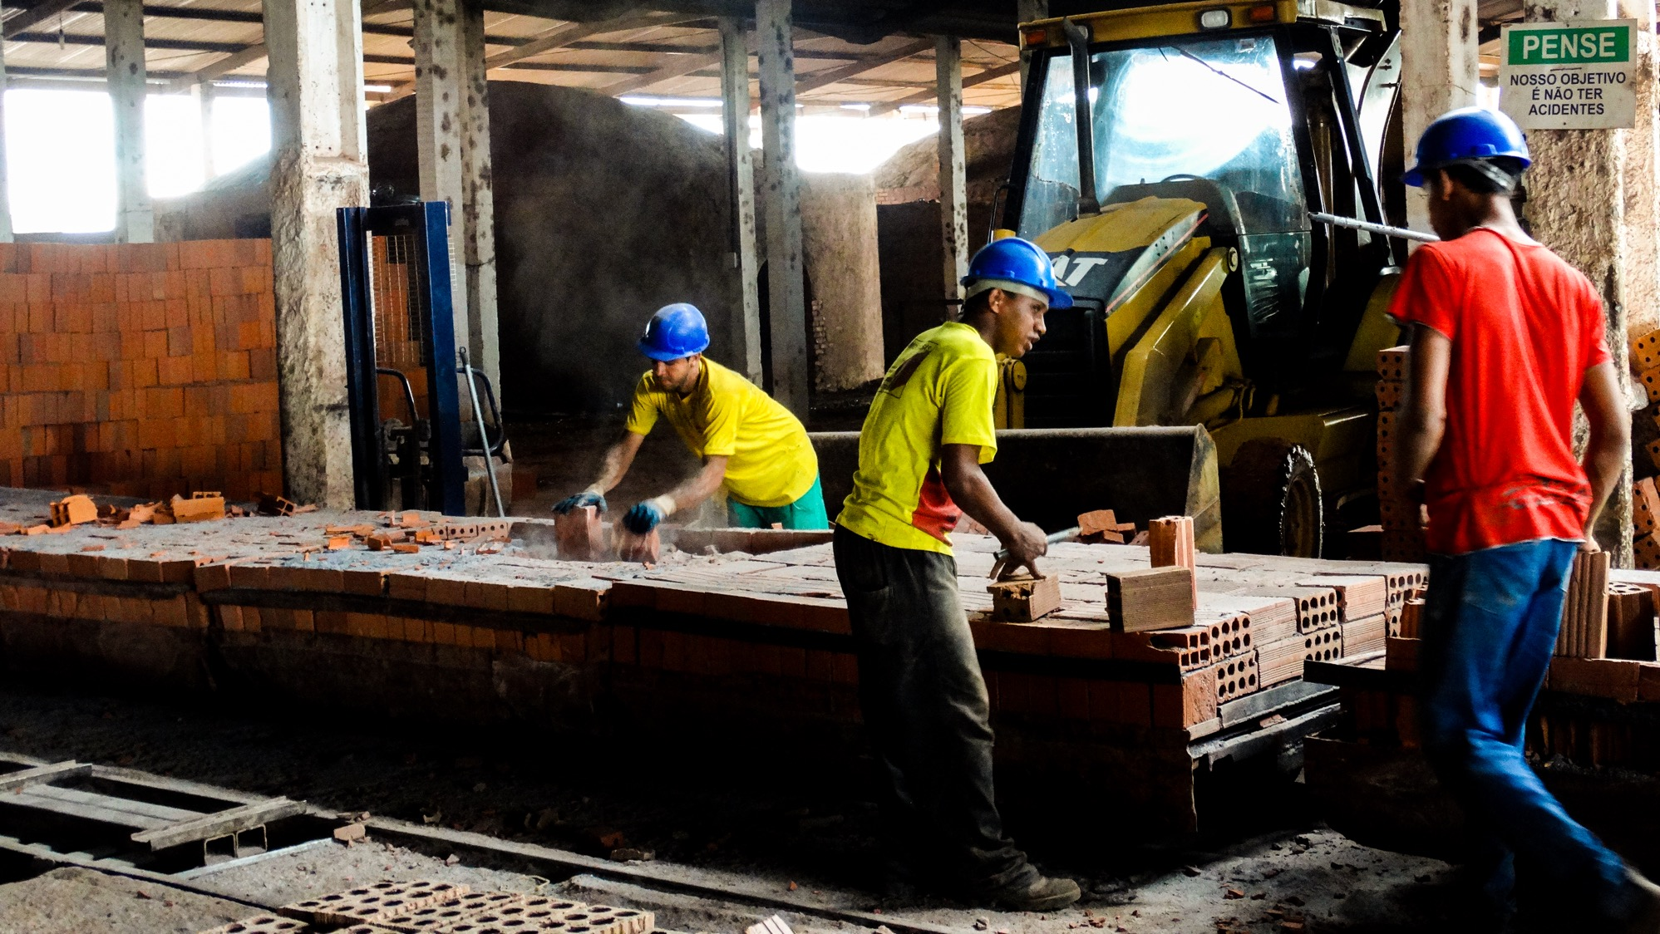
Challenges in addressing scope 3 emissions
Alberto Carrillo, Director of Science Based Targets and RE Procurement, CDP

Slide 2
Grow to Zero
Challenges in Addressing Scope 3 Emissions
Alberto Carrillo Pineda
Director, Science Based Targets and RE Procurement
19 April 2018

Slide 3
Agenda
Challenges in addressing scope 3 emissions
Best practices in scope 3 target setting and emissions reductions
Introduction to/overview of Compendium of Best Practices for Scope 3 GHG Management

Slide 4
Challenges in addressing scope 3 emissions

Slide 5
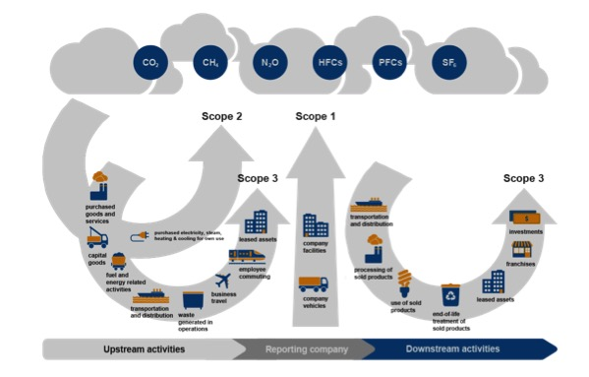
Why should we address scope 3?
S3 represents the largest impact for most sectors
Having a Scope 3 target allows and motivates companies to focus where they can have the largest impact
Scope 3 targets help build momentum and help drive action with suppliers and customers
Engaging with and managing your supply chain and customers helps ensure that your business is safe and sustainable.
Source: GHG Protocol
Notes:
Supply chain bullet:
About 40% of the global GHG emissions are driven or influenced by companies' purchases or sold products, according to CDP data.
Ask everyone to raise their hand and then if they meet the following, lower their hand:
They have not conducted a scope 3 screening i.e. they do not have an
estimation of emissions in each scope 3 category
They have not conducted a scope 3 inventory in any category
They do not know whether there have been any disruptions in their supply
chain in the past year (natural disasters, regulation etc.)
They are aware of disruptions but have not engaged their supply chain
They have not set emission reduction targets for their supply chain
Their targets have not been approved by the SBTi
If anyone is still standing – they are on track to meet their science-based target
Example of supply chain disruption: KFC couldn’t sell chicken
Customers
Businesses are seeing an increased demand for sustainable products
The food and beverage processing (30 companies) and consumer products & durables (24 companiessectors are 2 of the 3 sectors engaged with the SBTi
Exxample: More efficient technologies save customer electricity consumption and keep their costs down

Slide 6
Challenges in addressing scope 3
Collecting data from and engaging with large numbers of companies and from SMEs
Not having direct influence
Lack of accounting methods for all sectors
Lack of sector-specific best practices and guidance
Notes:
Collecting data from and engaging with large numbers of companies and from SMEs:
We’ll go over CDP’s supply chain program can help address this
Supply chains can have thousands of companies and emissions can be several tiers away
SMEs have limited resources
Not having direct influence:
- It’s in everyone’s interest to address their emissions (increased efficiency, enhanced reputation, preparation in advance of regulation, correlations with financial returns etc.)
Lack of accounting methods for all sectors:
- Land use change for example
Lack of guidance:
- Even if there are ways to account for emissions – see the GHG protocol – there challenges especially given the number of sectors and activities

Slide 7
Best practices in scope 3 target setting
and emissions reductions

Slide 8



Science Based Targets initiative
The Science Based Targets initiative champions science-based target setting as a powerful way of boosting companies’ competitive advantage in the transition to the low-carbon economy.

Slide 9
Science Based Targets initiative
VISION
Science-based GHG emission reduction target setting will become standard practice and corporations will be contributing to closing the emissions gap left by country commitments.
STRATEGIES
Reduce the barriers to the adoption of science-based targets
Institutionalize the adoption of science-based emission reduction targets
Create a critical mass
Notes:
As part of our strategy we are defining best practices in science-based target setting and have created criteria against which we validate company targets. These criteria not only ensure targets are in line with climate science, but exhibit the qualities that demonstrate that the targets are meaningful and ambitious.
A full list of criteria are available on the SBTi website sciencebasedtargets.org including criteria on scopes 1 and 2.

Slide 10
Summary of SBT scope 3 criteria
Boundary
Timeframe
Complete a scope 3 screening. If scope 3 emissions are > 40% of total emissions, a scope 3 target is required. The scope 3 target boundary must include the majority (two-thirds) of value chain emissions.
Target years must cover 5 to 15 years from date target is submitted to SBTi for validation. Long-term targets are recommended.
Ambition
Additional guidance
Targets should clearly demonstrate how the company is addressing the main sources of GHG emissions in line with current best practice.
Offsets are not counted as reductions towards SBTs.
SBTs shall not cover avoided emissions.

Slide 11

Best practices - ambition
Absolute emission reduction targets in line with the decarbonization level required to keep global temperature increase below 2°C (i.e. absolute contraction approach).
Physical or economic emissions intensity reductions consistent with the decarbonization level required to keep global temperature increase below 2°C (Sectoral Decarbonization Approach or GEVA).
Other targets where the company can demonstrate that the target is ambitious and does not result in absolute emissions growth.

Slide 12

Best practices – supplier engagement
Supplier engagement targets should cover either 2/3 or more of cradle to gate emissions or, if that information is not available, 2/3 or more of annual procurement spend.
At a minimum, the company’s suppliers should set science-based emission reduction targets on their scope 1 and scope 2 emissions. Inclusion of suppliers’ scope 3 emissions is also encouraged.
Supplier engagement targets should cover a maximum of 5 years from the date the target is submitted to the SBTi for an official validation.

Slide 13

Targets not considered relevant/ambitious
Targets to collect data.
Targets that cover avoided emissions (e.g. emissions reduced against a BAU baseline).
Targets already that have already been achieved or nearly completed.
Targets without a set base or target year.
Notes:
Other challenging or unambitious targets:
Supplier engagement targets, difficult to estimate the % of emissions covered
Targets resulting in an increase of emissions are required more scrutiny (some sector-based methods for scope 3 not yet approved)
Absolute targets that result in a decrease in absolute emissions not in line with science are extensively argued (companies attempt to justify little decrease with growth projections)
Assessing baseline for companies for which scope 3 widely vary year to year (e.g. construction companies)
Combined targets create difficulty in assessing ambition per scope

Slide 14
Introduction to/overview of Compendium of Best Practices for Scope 3 GHG Management

Slide 15
Compendium of best practices in addressing scope 3 emissions
The compendium will cover reducing emissions and measuring impact.
Nearly all scope 3 emissions are either in purchased goods and services or the use of sold products categories. Therefore, we will also develop guidance on these three themes:
Supply chain targets in general
Supply chain engagement targets
Use of sold products targets
Best practices will be illustrated with five case studies
If you have any examples of best practices or innovative ways to tackle scope 3, please contact us.
Notes:
Will be launched at COP later this year

Slide 16
Resources to consult in the meantime
SBTi target validation criteria
SBT manual
GHG Protocol
Scope 3 evaluator tool
CDP supply chain program

Slide 17
www.sciencebasedtargets.org
info@sciencebasedtargets.org

