Slide 1
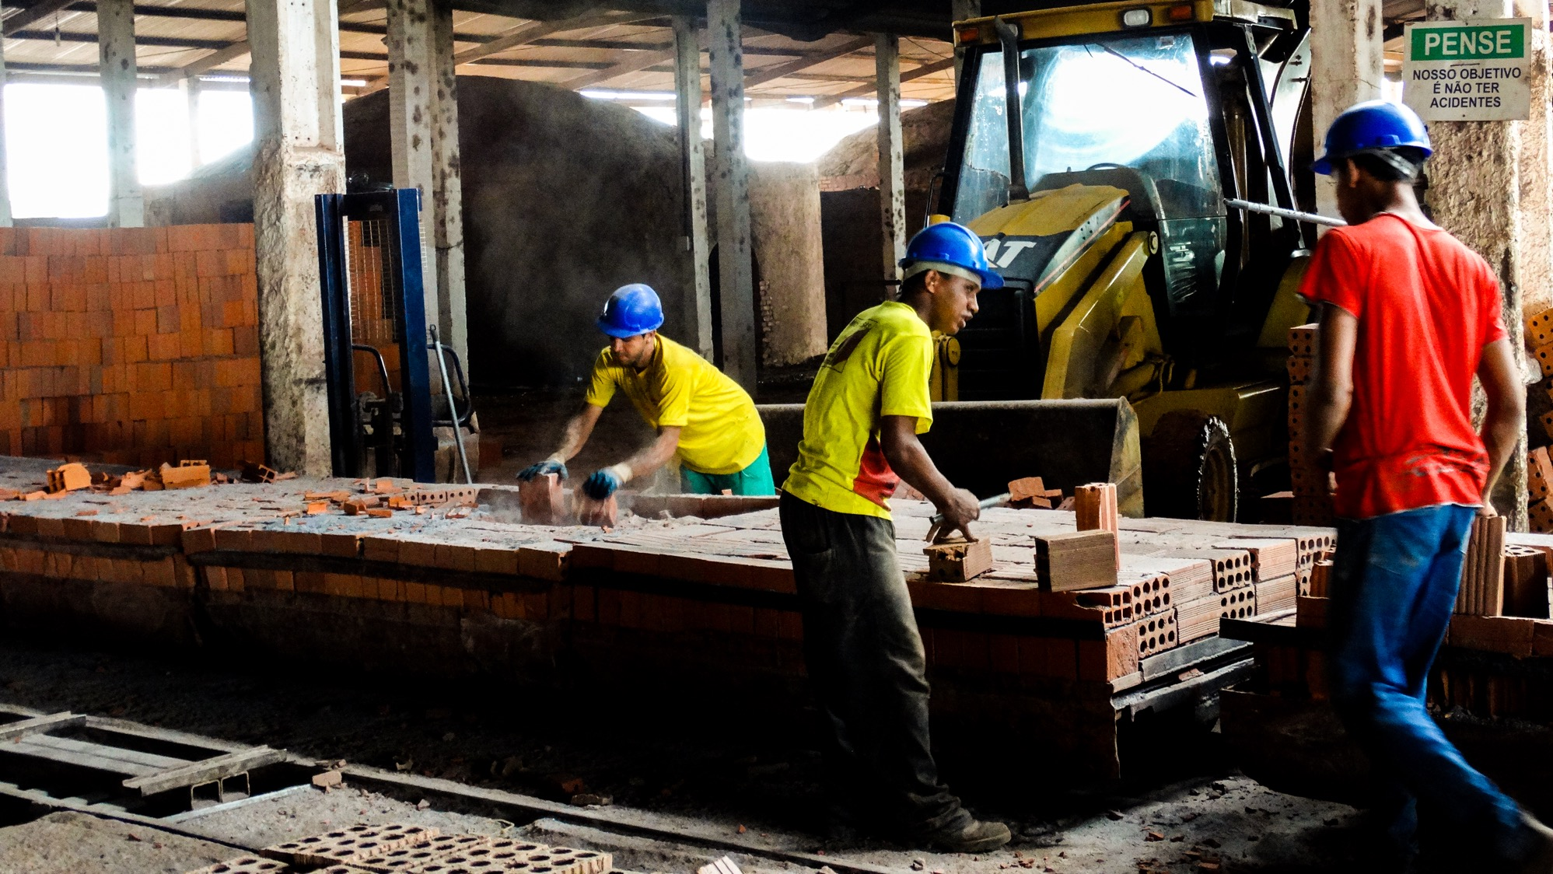
Data collection & supply change engagement
Kate Redington, Associate Director Sales & Business Development, CDP

Slide 2


Data collection and supply chain engagement
CDP Supply Chain program
Kate Redington
Associate Director Business Development, CDP Europe
Apr 19th 2018

Slide 3


The global environmental disclosure platform
600+ Investors and
100+ large corporations
Decision Criteria: Scores
Authority
Impact on Nature: Climate change, water, defore-station
Information
6300+ Companies and 500+ cities
> 80 countries

Slide 4

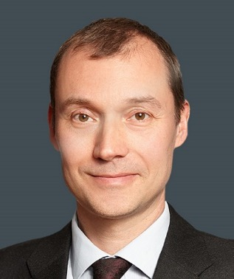
Private equity pays attention

In the last ten years we've seen a huge growth of interest in climate change and focus on the supply chain forms part of that. It has to


No longer can we just ignore the supply chain

Adam Black
Head of ESG & Sustainability
Coller Capital

Slide 5
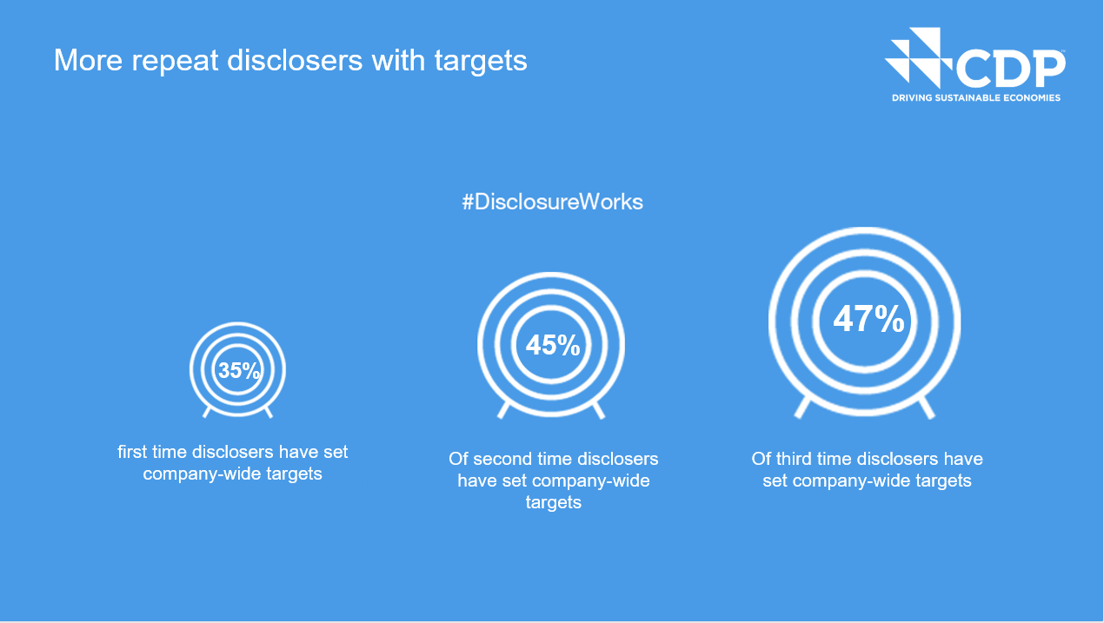


Source: CDP Reporter Services Analytics
Notes:
INSIGHT

Slide 6

Engaging your supply chain
www.cdp.net | @CDP

Slide 7
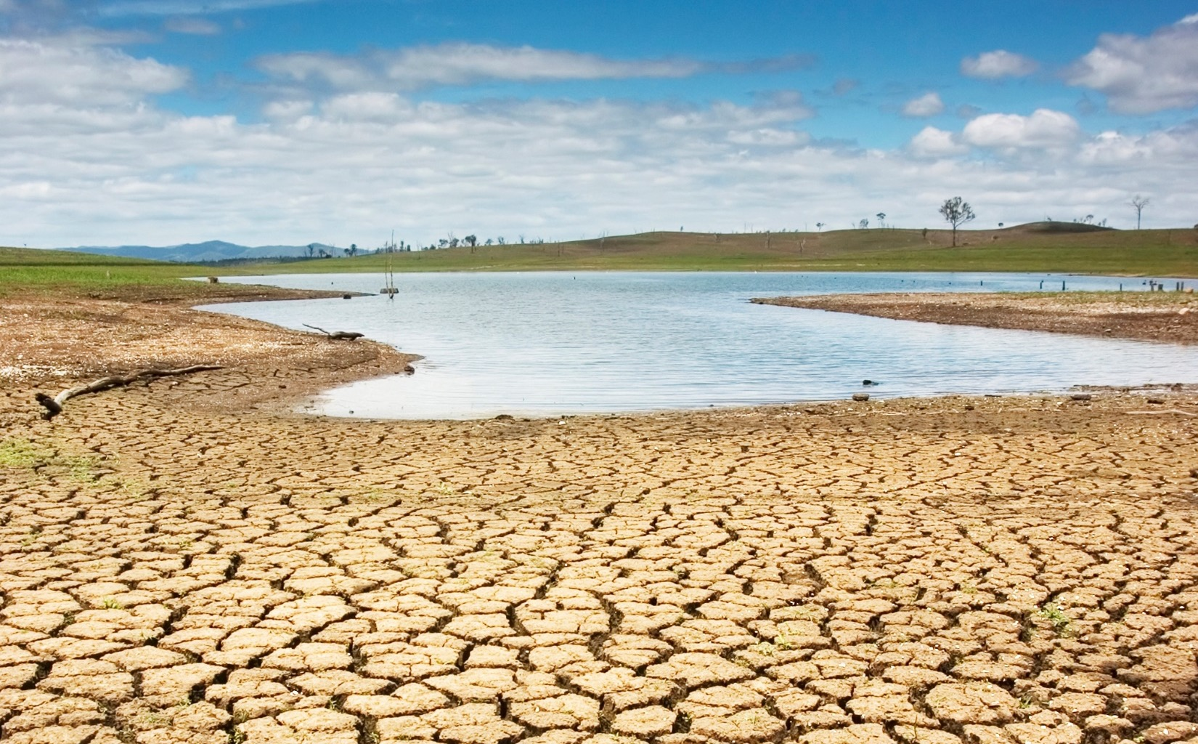
4:1
Average ratio of indirect supply chain emissions compared to direct operational emissions

Slide 8
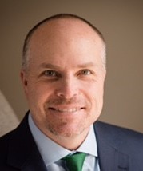
CPO insights

We are able to drive real action on this, because we’re the ones who pull the purse strings

Al Williams
Chief Procurement Officer
Barclays

Slide 9
































































































2017 supply chain members: 100 companies with $3tr requesting 9,800+ suppliers

Slide 10












Cascading the request down the supply chain
Retailers
FMCG
Manufacturing base

Slide 11

Supplier engagement to-date from 100 member companies worldwide
Supplier Water Disclosures
Supplier Climate Change Disclosures
1500+
4700+
47
Last year one supplier was asked to disclose climate information to CDP Supply Chain by 47 of their clients and the investor group
Page 5

Slide 12

551 million metric tons
of CO2e cut by suppliers
More than Brazil’s total emissions in 2016
Notes:
The suppliers responded to this member request to reduce emissions. The responding 4800 companies reported emissions reductions amounting to 551 million metric tonnes CO2, which is more than Brazil’s total emissions in 2016

Slide 13
cost savings of
= US$14 billion
Notes:
And translates into US$14 billion in cost savings. This shows how actionable and quantifiable emission reduction actions can help businesses to plan ahead and manage climate risks, while reaping the bottomline benefits.

Slide 14
There is a need for greater supplier engagement
However, the data shows that the gap between leading companies and a large sub-section of their suppliers persists. There is a need for greater engagement to enable suppliers to catch up
23%
of responding suppliers engage their own suppliers
On emissions reductions

Slide 15
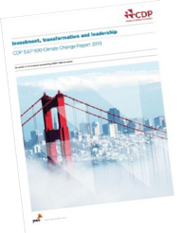
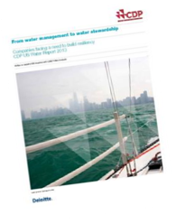
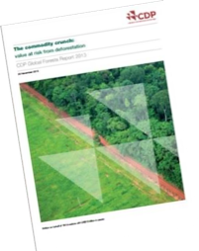
CDP Questionnaires for SC – We are now fully thematic
 Climate Change
 Water
 Forests
Key areas:
Key areas:
- Context
Key areas:
- Governance
Traceability
Targets
Certification standards
Risks & Opportunities
Strategy
Targets
Communications
- Risks & Opportunities
- Water Accounting
- Risks & Opportunities
Forest risk commodities:
Governance & Strategy
Compliance
Timber
Palm oil
Cattle production
Soy
Rubber (new in 2018)
- GHG emissions footprint & performance
- Targets & Initiatives
- Supplier module – allocation & collaboration
- Supplier module – fines & collaboration

Slide 16
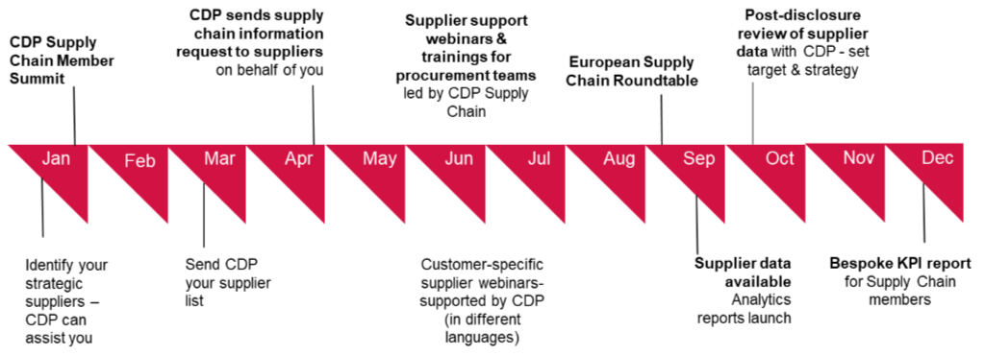
Timeline

Slide 17
Building supplier capacity
Year 4
Year 3
Collaboration
Year 2
Ambition
KPIs:
Suppliers reporting collaborative opportunities
Suppliers reporting organizational-level change in emissions reduction initiatives
Year 1
Reporting
KPIs:
KPIs:
# of suppliers reporting reduction targets
# of suppliers reporting emissions reduction initiatives
Suppliers allocating emissions
Participation
Encourage your suppliers to disclose to CDP
% of suppliers that report
risks & opportunities
# of suppliers reporting S1, S2 & S3 emissions
Page 31
Notes:
Can focus on certain data points when supplier start to submit in order to reduce their reporting burden

Slide 18
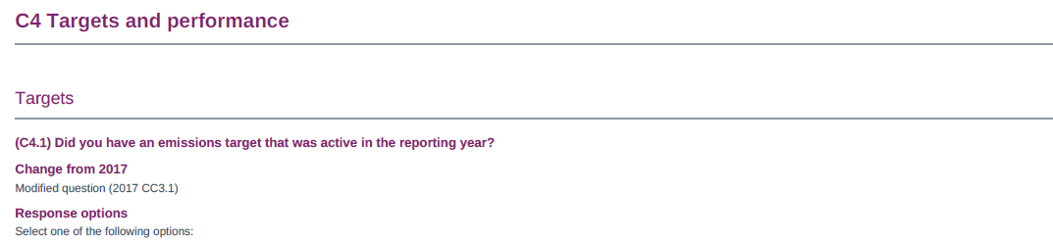
What we ask – Reduction target
  2. Have you set an operational emissions reduction target?
  (Question: C4)
  Create focus and spur ambition
  SMART
  Relative or absolute?
  Science based- targets
“Reduce emissions by X% by 2020 on a X baseline”

Slide 19
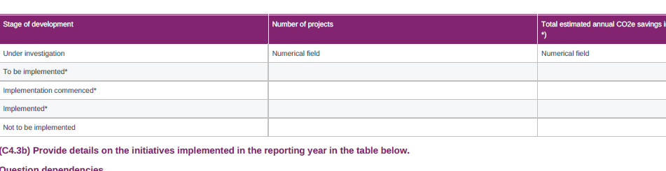
What we ask – Reduce emissions
  Have you reduced your emissions? (Question: C4)

Slide 20
Example of emissions reduction initiatives
Low-carbon energy purchase
Emissions reduced: 1494000 mtCO2e
“During 2016, we significantly increased our renewable energy investments. We grew our renewable energy from 100% in US during 2015, to 100% in US and all European Union countries in 2016. Renewable energy is now used for 80% of our global power use.”
Process emissions reductions
Emissions reduced: 411000 mtCO2e
“We reduced the amount of electricity required to operate telecommunications service facilities by rationalizing equipment in line with the volume of traffic in telephone facilities and switching to highly energy efficient IP network equipment.”

Slide 21
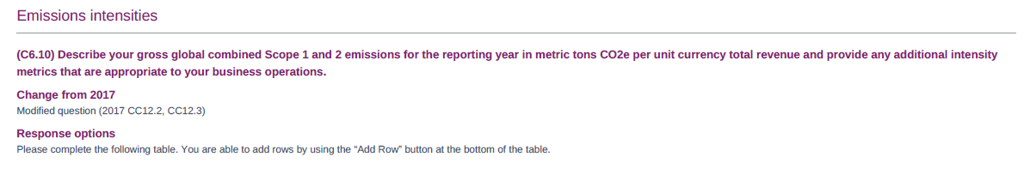
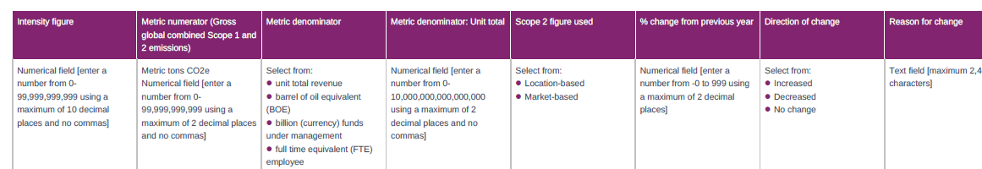
What we ask – Report intensities
  3. Disclose your operational emissions intensity?
  Gross Scope1 + Scope2 / Revenue
  (Question: C6.10)

Slide 22
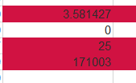

How to report emissions intensities
  Example of inaccurate intensity figures
  Example of accurate intensity figures

Slide 23
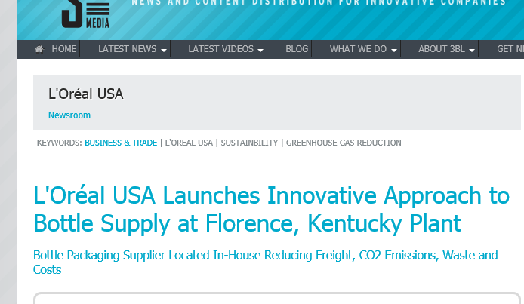
What we ask - Collaboration
  Collaborating to drive change (Question: SC 2.1)
Sourcing alternatives:
KPMG UK switching to push bike couriers saved 476tCO2 and £8200.
 
To achieve a reduction in KPMG’s scope 3 carbon emissions, Swiss Post Solutions has developed its management of KPMG’s courier suppliers with the objective of migrating motorbike courier deliveries to pushbikes, to achieve zero emissions. Swiss Post Solutions continued work with the courier suppliers has delivered an increased pushbike fleet capacity and resulted in 38% of same day deliveries being made using pushbikes 
Changing the way you work together:
L'Oréal on site production switch led to 400,000 freight miles being eliminated.

Slide 24
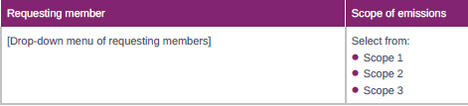
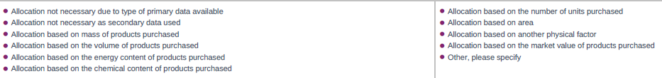
SC1.1 Emissions Allocation
Define the scope of your emissions to allocate to your customer
Select your customer
Select your allocation method

Slide 25
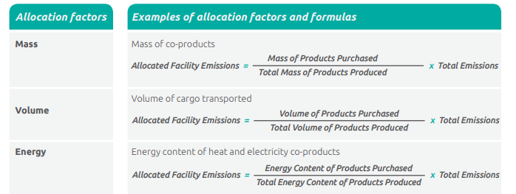
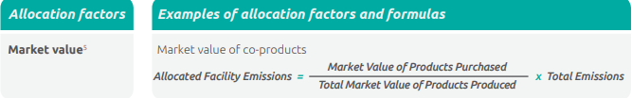
Allocation methods and factors
Physical allocation
Economic allocation
You can find further guidance in the GHG Protocol Corporate Value Chain Standard

Slide 26

CPO insights

We absolutely exit suppliers if they don't address environmental issues. We must take very serious measures. And the companies see who is no longer in the room


The focus of future supply chain sustainability is platforms like CDP's supply chain program. Cross working platforms getting organizations to work together

Anna Spinelli
Senior Vice President Procurement
Philips Lighting

Slide 27
Criteria companies didn’t meet
Scopes 1 and 2
Scope 3
Notes:
Scope 3 is the biggest challenge for companies
We looked at targets validated last year for CDP scoring season and about 2/3 of companies that didn't pass failed to meet one of the scope 3 criteria, mainly because the scope 3 target wasn't sufficiently ambitious or because they hadn't conducted a screening.

Slide 28


Achieving SBT: BT - encouraging renewable energy purchasing
 “How will we meet our new supply chain target? Close cooperation with our suppliers will be key. We will be working together to help them switch to renewable energy, and encouraging more of them to report to CDP. This is a critical first step towards action for suppliers, and the data they disclose will enable us to track emissions reductions and uptake of renewable energy in our supply chain”.

Gabrielle Ginér, Head of Sustainable Business Policy at BT Group
67.6%
67.6%
Our supply chain
3: 1
6.7%
BT’s end-to-end
carbon emissions
As at 31 March
2017
Our own operations
We will help
customers reduce
carbon by three
times…
6.7%
We will help
customers reduce
carbon by three
times…
…BT’s end-to-end carbon emissions
25.7%
25.7%
Customer use and disposal of
our products
We will reduce the carbon emissions
Associated with our supply chain on
2016/17 levels by 29% by 2030
Notes:
Example of: Operational, reputational and regulatory risk
As I mentioned a minute ago, Golden-Agri Resources reported reduced fruit production at as a result of the haze from Indonesia’s forests fires that have taken place the past few years. Asia Pulp and Paper also reported significant damage to their brand on international markets as a result of this.
The increasing demand and geographical habitat distribution of oil palms naturally puts their growth directly at odds with many of the planet’s most important forest ecosystems. The south-east Asian rainforests in Indonesia and Malaysia have felt the brunt of this expansion. Forest fires have become an annual occurrence as peat forest is drained and then cleared using slash and burn techniques. As the underlying peat is dried it become extremely flammable and fires, once started, can continue for months.
One prolonged period of fires beginning in late 2015 and continuing well into 2016, created:
Highest concentration of carbon monoxide ever observed
Produced more GHG emissions per day than the entire US economy.
Cost the Indonesian economy an estimated USD 16.1 bn.
Caused more than 100,000 deaths across the region (Harvard and Columbia university study).

Slide 29
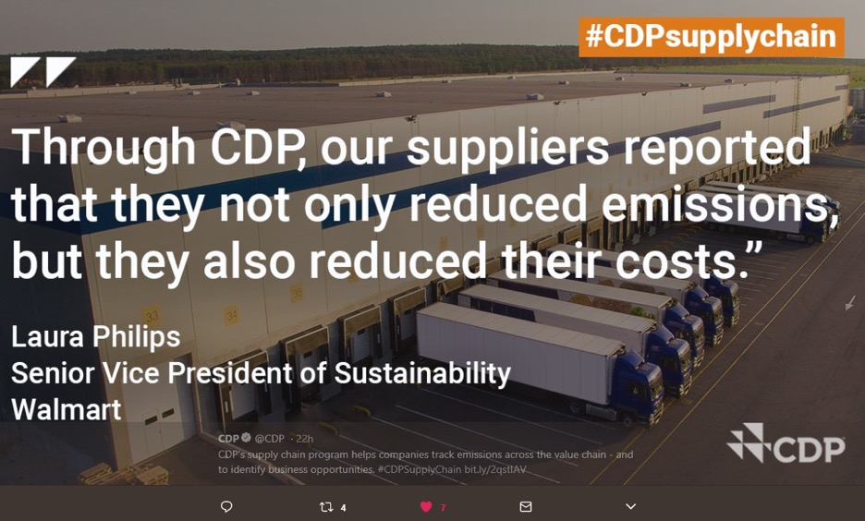

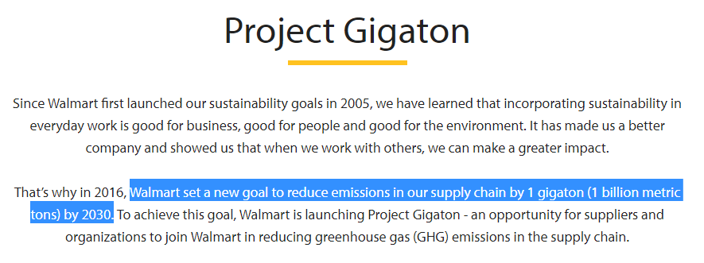
Achieving SBT: Walmart - encouraging more action on emissions
Notes:
Example of: Operational, reputational and regulatory risk
As I mentioned a minute ago, Golden-Agri Resources reported reduced fruit production at as a result of the haze from Indonesia’s forests fires that have taken place the past few years. Asia Pulp and Paper also reported significant damage to their brand on international markets as a result of this.
The increasing demand and geographical habitat distribution of oil palms naturally puts their growth directly at odds with many of the planet’s most important forest ecosystems. The south-east Asian rainforests in Indonesia and Malaysia have felt the brunt of this expansion. Forest fires have become an annual occurrence as peat forest is drained and then cleared using slash and burn techniques. As the underlying peat is dried it become extremely flammable and fires, once started, can continue for months.
One prolonged period of fires beginning in late 2015 and continuing well into 2016, created:
Highest concentration of carbon monoxide ever observed
Produced more GHG emissions per day than the entire US economy.
Cost the Indonesian economy an estimated USD 16.1 bn.
Caused more than 100,000 deaths across the region (Harvard and Columbia university study).

Slide 30

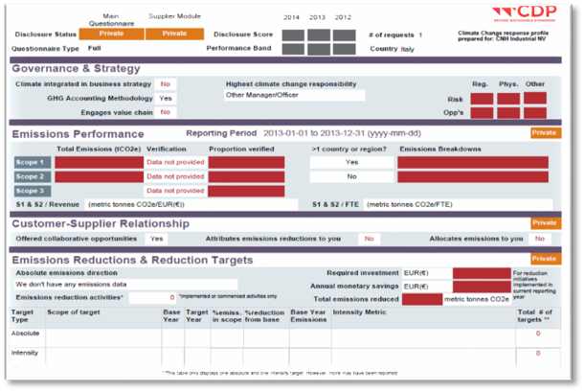
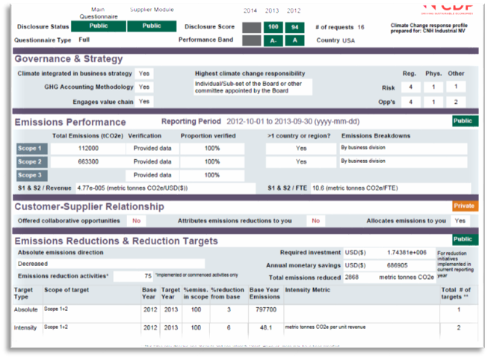

L'Oréal: Scorecards and procurement training
www.cdp.net | @CDP
Incomplete response scorecard

Engaging and training L’Oréal buyers has made it possible to mobilize suppliers and convince that measures aimed at reducing greenhouse gas emissions play an inevitable part of a company’s global performance. CDP’s supply chain scoring is then part of supplier’s evaluation. Suppliers’ performance on climate change is fully included in supplier relationship and challenged during business reviews.
Miguel Castellanos, Director of Global Safety, Health & Environment, L’Oréal
 
✓
Complete response scorecard
Page 28

Slide 31

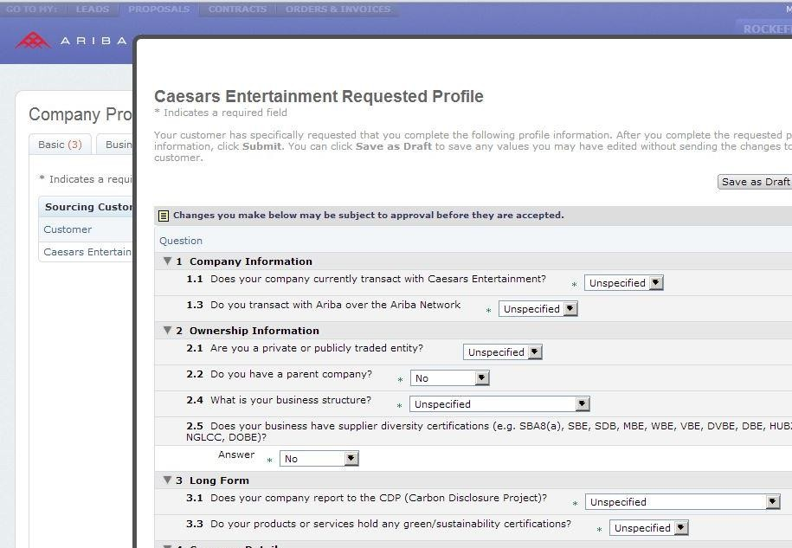


Caesars Entertainment: Price negotiation and supplier onboarding
www.cdp.net | @CDP

Slide 32
CDP Action Exchange initiative
A platform to accelerate the action taken on climate change in supply chains
Through Action Exchange, CDP and Supply Chain program members can help suppliers:
Identify emissions reduction opportunities and cost savings potential
Connect with technology and solutions providers
Address common barriers to investing in emissions reduction activities
US$14 billion
savings from emissions reduction projections reported by over 4,800 supplier respondents in 2017.
Over one third of reported emissions reduction projects resulted in savings of at least US$100,000

Slide 33

Review of 3 years
Members asking more suppliers to take part every year and tracking participation levels.
Number of suppliers participating in AEX
 Jaguar Land Rover is aiming to have the vast majority of its strategic supplier partners taking action to reduce emissions and reporting them through CDP Supply Chain…We will also be joining the CDP Action Exchange program to help Jaguar Land Rover suppliers look for further opportunities or innovative solutions in the marketplace to reduce their carbon emissions.


Slide 34
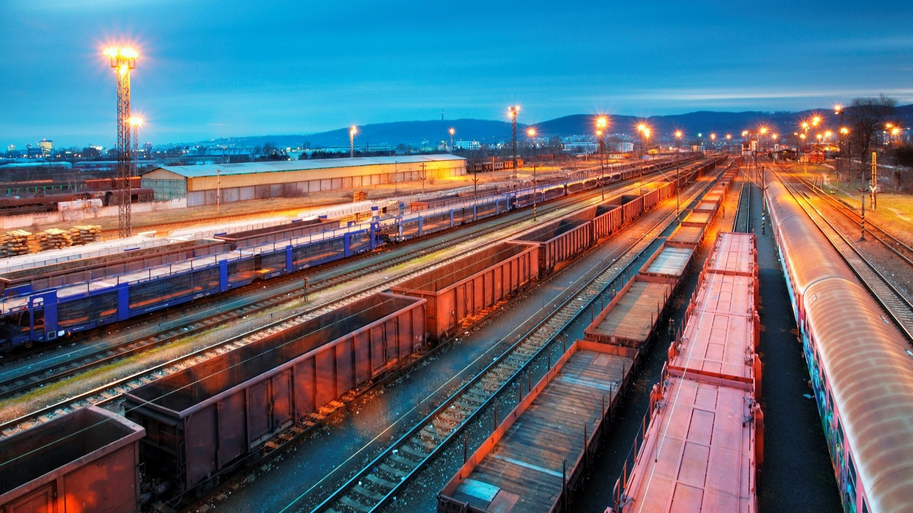
Action Exchange: Case study
Creative incorporated recommendations from CDP’s action plan into their sustainability goals/business plan and implemented them.
Replaced hydraulic machines with all-electric:
  50% reduction in energy consumption
  Investment payback period: 2.5 years
Worked with a CDP recommended solutions provider – Phillips Lighting – to switch all lighting to LED.
Creative Group of Industries
Plastics manufacturer based in India
Requested by Unilever and Wal-mart
Potential savings for Creative as a result of AEX
GHG reductions: 20,000 MtCO₂e
Cost: US$2million a year

Slide 35
Any questions?
Thank you!
Kate Redington kate.redington@cdp.net
www.cdp.net | @CDP

