Slide 1
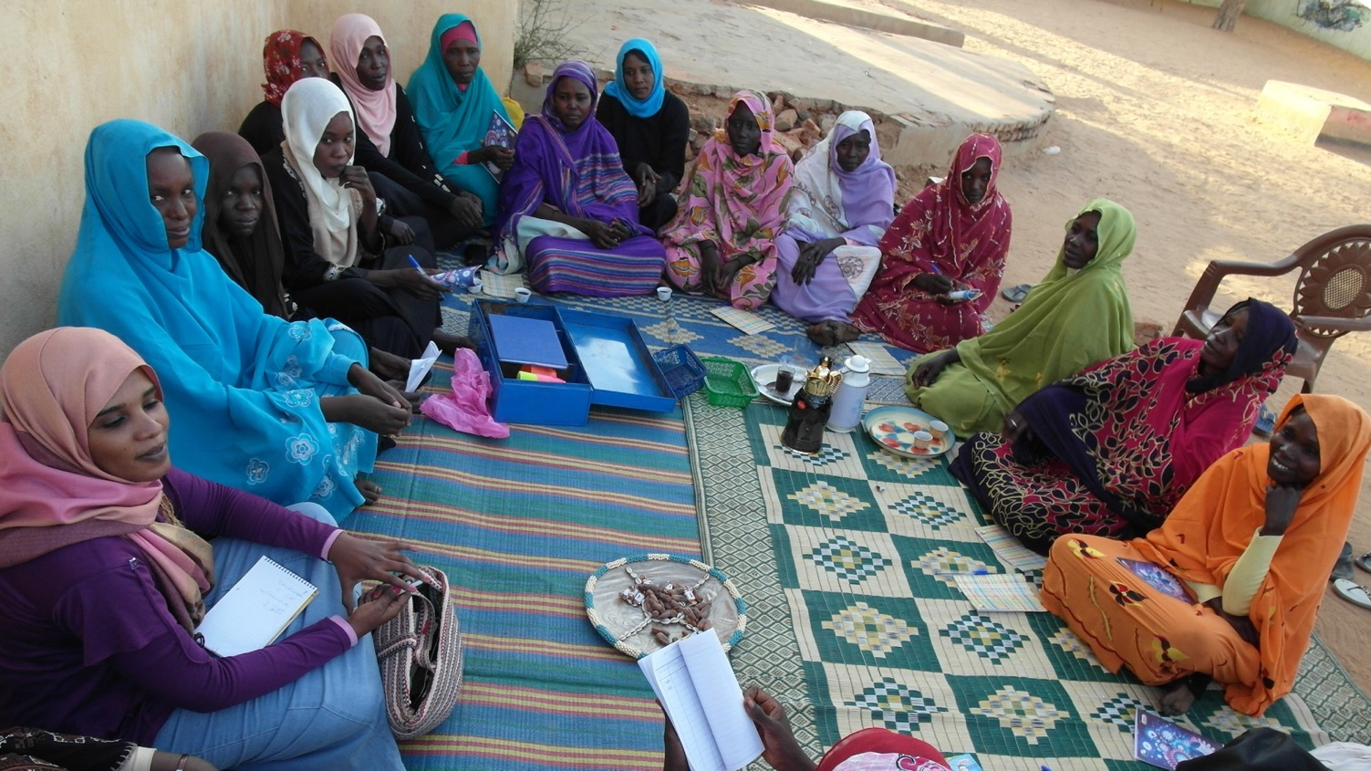
CAPACITY BUILDING: Gold Standard for the Global Goals projects
PROJECT DEVELOPER + NGO TRACK
Abhishek Goyal, Senior Technical Director, Gold Standard
Vikash Talyan, Technical Director, Gold Standard
SOCIAL MEDIA
@cdmgoldstandard
#GrowToZero
WWW.SLIDO.COM
1025
WIFI
Network: Gold Standard
Password: 180418GoldStandard

Slide 2
Overview
  Background
  New Elements of the Standard
  Learnings till date
  Recent Updates
  Planned Updates
  Group Discussions

Slide 3

Background
A next-generation standard to quantify, certify and maximise impacts toward climate security and sustainable development

Slide 4
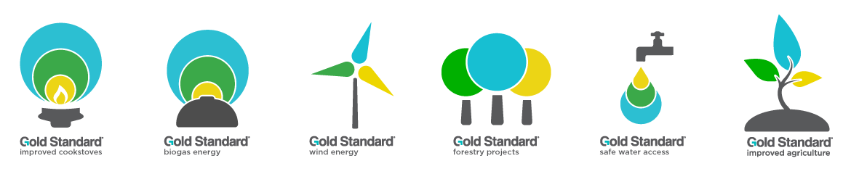
Background: Applications of the Standard
Environmental markets (voluntary + compliance carbon markets, RE markets) | Results-based finance for development | Corporate climate + SDG reporting | Large-scale climate + development action

Slide 5
How the Standard Works
Gold Standard projects are required to demonstrate that Gold Standard principles are captured in the project design and monitoring plan and are then subject to MRV. Gold Standard for the Global Goals is explicitly structured around these core principles as follows:
1 - Contribution to Climate Security & Sustainable Development
Demonstrate 3 SDG contributions, one must be SDG13.
2 - Safeguarding Principles
Undergo Risk Assessment
3 - Stakeholder Inclusivity
4 - Demonstration of Real Outcomes
5 - Financial Additionality and Financial Need
Carry out a stakeholder consultation and include in design
Create Monitoring Plan
Undergo Performance Certification
Prove up front Financial Additionality (impact certification)

Slide 6
New Elements of the Standard

Slide 7
Certification pathways
Pathways | Certified Outcomes Statements | Certified Products
Purpose | Statements to certify an outcome from an activity Not mandatory to follow GS approved meth | Certified Products are designed to generate finance for an activity by their trade within market mechanisms Follows GS approved meth
Market commodity | No | Yes
Typical use | Quantification for Reporting | Impact Quantification for trade
Example | SDG -3 Health outcomes | VERs or GS-CERs Renewable Energy Labels
Notes:
Note that all projects have to prove contributions towards the SDGs

Slide 8
Multiple Assets
  Allows any number of Gold Standard Certified Products following specific methodologies and product requirements.
  Stacking is clearly regulated.
  For examples
VERs + ADALYs | ✔️
VERs + RECs for same MWh | ✖️

Slide 9
Claims Guidelines
  Defines the claims that can be made and directs their use in relation to Gold Standard Certification
  Assist project developers, partners and funders in communicating accurately and appropriately about the benefits derived from Gold Standard projects.
  Provides clear guidelines on SDG claims
    For example
Certified Outcome Statements
SDG 13 impacts – Black Carbon/SLCPs reduction
SDG 13 impacts – Emission Reductions
SDG 3 impacts – Health Impact (ADALYs)
SDG 7 impacts – Renewable Energy Labels

Slide 10
SDG claims
Example- in the case of a Gold Standard Improved Cookstove project that issues both VERs and ADALYs:
Claims | VER funder | ADALYs funder
SDG 13 - Climate Action | Claims to have funded Certified SDG – 13 Climate impacts | May only include reference to project’s climate impacts but must not suggest or imply to have funded them
SDG 3 – Good Health and Well being | May only include reference to project’s health impacts but must not suggest or imply to have funded them | Claims to have funded certified SDG – 3 Good Health and Well being impacts
Other SDG Impacts | May include narrative around SDG outcomes like new job creation and reduced time spent collecting wood | May include narrative around SDG outcomes like new job creation and reduced time spent collecting wood

Slide 11
SDG Claims – Transition projects
  Eligible to make the similar claims as projects that are developed under GS4GG
  Potential restrictions are limited to claims around “gender sensitive” or “water sensitive”, which require enhanced safeguards assessment at the beginning of project design

Slide 12


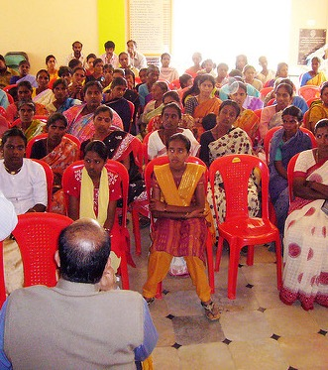
SDG 5: GENDER EQUALITY
Gender safeguards
Enhanced safeguards at the project design level, enabling all projects to be labeled “gender sensitive.”
Certified SDG Impacts
New guidelines developed to quantify and certify impacts, potentially on:
  Women’s economic empowerment
  Reduction in time poverty
  Women’s voice and agency

Slide 13
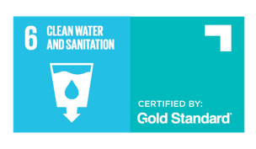
SDG 6: WATER BENEFIT CERTIFICATES
Water safeguards
Enhanced safeguards at the project design level, enabling relevant projects to be labeled “water aware.”
Water Benefit Certificates
Gold Standard Certified SDG Impacts quantifying the water purified, supplied or conserved

Slide 14
Land use updates
Validated certificates are now known as Planned Emission Reductions (PERs)
PERs can be issued only on 5-year cycles. For a new 5-yr cycle to be issued, 100% of the already issued PERs must be converted in VERs
Activity Requirements
  A/R Requirements and AGR Requirements now combined into LUF Activity Requirements
  Dedicated section on New Area certification

Slide 15
REC label
Renewable Energy Attribute Certificates (REACs) are used to certify that given amount of energy has been generated from renewable source.
The Gold Standard RE Label was developed to address a demand in market for high quality Renewable Energy Attribute Certificates*
The GS label certifies that the electricity has been generated by a project in line with Gold Standard principles:
Local stakeholders involved
Safeguard assessment conducted
Contribution to 3 SDGs
*Currently, iRECs are the only certificate approved for labelling with Gold Standard

Slide 16
Standard Update Procedure
  Regular updates
    The planned date for subsequent updates is announced with the release of each update
  Urgent updates
    Follow a systematic process to update all stakeholders via emails etc. on urgent revisions carried out.
  Stakeholders may submit anytime suggested updates, edits, changes or additions to GS4GG by submission to help@goldstandard.org
  The Stakeholder feedback is considered as per GS’s Standards Setting Procedure.

Slide 17
Learnings till date

Slide 18
Key Learnings
Ongoing Financial Needs
Demonstration of OFN is challenging
Causes significant uncertainty for project
Crediting Period
Change in approved crediting period length from 21 to 10 or 15 years would create risks for projects
Reporting on SD indicators
Challenging to align the approved SD indicators with SDG targets
Impractical to change monitoring plans ex-post
Notes:
Gold Standard for the Global Goals introduced
a new 5 year certification cycle.
It also limits maximum certification periods to 10 years as a default, 15 years in the case of Renewable Energy or Community Services Activities or 30 to 50 years in the case of A/R Projects.

Slide 19
Recent Updates

Slide 20
Updates
Ongoing Financial Needs
Qualitative narrative to demonstrate how GS certification is material
Submission of information mandatory but not used to make decision on CP renewal
Crediting Period
Transition projects shall maintain their existing crediting cycle and maximum crediting period length
VPAs/CPAs submitted after the first certification cycle of the PoA shall apply the GS4GG Certification Cycle
Reporting on SD indicators
Projects transitioning to GS4GG may retain their existing SD monitoring plan, including indicators previously approved.
Brief explanation showing link between SD indicators and most relevant SDG target
Notes:
Transition Projects shall maintain their existing crediting cycle and maximum crediting periods upon transition to GS4GG, specifically as follows:
- A 10 year fixed crediting period project shall retain the balance of its 10 year period post-transition.
- A 7 year renewable project shall maintain the balance of its existing crediting period upon renewal. Its future renewals shall take place as per a 7 year cycle instead of 5 as envisaged under GS4GG, up to the maximum 21 years.
- A/R Projects shall continue as per the existing 5 year cycle.
- For PoAs any VPA submitted within the first crediting period (i.e. 7 years) of the PoA shall be allowed to use the same 7 year, twice renewal model. All VPAs/CPAs submitted after the first crediting period of PoA shall apply the GS4GG Certification Cycle (i.e. 5 year renewals).
Rationale: The update allows existing projects to maintain their maximum crediting periods as envisaged at Registration.
OFN
- Provide a qualitative narrative, supported by an overview of project finances, that demonstrates how the finance derived Gold Standard certification is material to the ongoing sustainability of the Project.
- Information highlighting the key categories and amounts or relative proportions (%) of project income and outgoings, including the relative proportion of certification related cost and revenue.
- Gather information on OFN and review how GS finance is supporting projects, with a view to creating future improvements.
Rationale - minimize the disruption and additional work for existing projects that may be caused by re-designing an existing Monitoring Plan

Slide 21
Other updates
Clarified and harmonized key terms such as: Design Certification/ Design Certification Renewal, Performance Certification
Clarified and harmonized key terms like Design Review, Performance Review and how this relates to Design Certification/ Design Certification Renewal, Performance Certification
Provided updated Templates for
GS4GG Annual Report
Microscale Validation Appraisal Reports (at both validation and verification)

Slide 22
Microsite update
Restructured microsite for easy navigation
Made all project development Templates available on one page
Provided search, filters for each page
Included a document Info box that shows all previous versions, tracked change versions and other key information about the document
In addition to an online view, made direct downloads for PDFs much more straightforward

Slide 23
Planned Updates

Slide 24
Key planned updates
Standard Updates
  Update the templates
  Publication of process to request deviations from the standard
  Standard tools for SDG impact valuation
  Stakeholder consultation on M&E system for evaluation of outcomes and impacts at portfolio level
Microsite Updates:
Improved Rule Update section
More training resources/guide to developing a GS4GG project
Notes:
1. Most of this is governed by ISEAL requirements.

Slide 25
Planned land use updates
  Dedicated PDD template for LUF project
  Revise and update the Smallholder and Microscale Guidelines
  Release of a guideline document to conduct spatial evaluation for forest/non-forest assessment
Notes:
1. Most of this is governed by ISEAL requirements.

Slide 26
Group discussion
REC labelling – Richard Iliffe
Land use change (agriculture and Forestry) – Giancarlo Raschio
GS4GG transition and other rule clarification – Vikash Talyan

